Slide 1
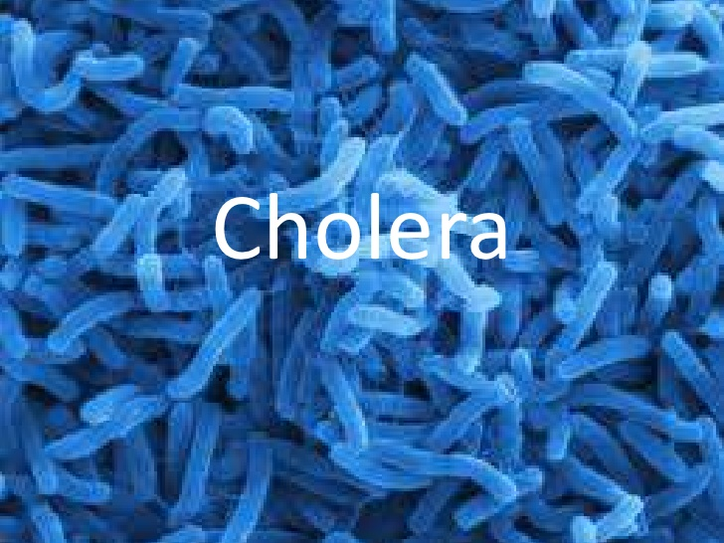
Notes:
Cholera is caused by bacteria that have the ability to survive the harsh environment of the gastrointestinal tract. The v, cholera bacteria releases a toxic enzyme that causes vomiting and diarrhea. The primary symptom that causes mortality in cholera is the dehydration. Cholera had been designated the blue death due to the physical attributes of blue skin tone and dehydration of the victims who succumbed to the disease. The works of CDC (2015) and Rosenberg (1987) were accessed.

Slide 2
Notes:
Cholera is the causal attribute of a number of different ills which include dehydration, diarrhea and vomiting. In addition, cholera is the causal attribute of severe fatigue. In the circumstance of cholera, the diarrhea that is emitted is painless in addition to the vomitus of the patient having a clear watery quality. The clear watery quality of the vomitus and fecal emission imply that substantial quantities of water are being released by the victim. These symptoms take place anywhere between 24 hours and a week subsequent to the initial contact with the cholera bacteria (CDC, 2015; Rosenberg, 1987).

Slide 3
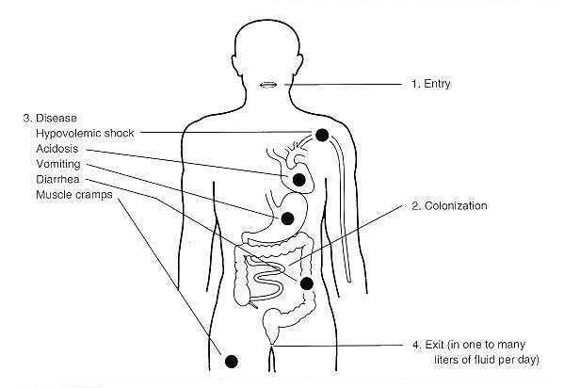
Notes:
Studies have shown that cholera is communicated by the contamination of water and food from fecal waste products of individuals who have been infected with the illness. The bacteria have the capacity of subsisting in almost any type of surrounding. The people who have the greatest susceptibility to cholera are usually the elderly and infirm who have a lowered quality of immunological defense. In addition, the elderly and the inform have a greater probability of deriving serious health challenges as a result of cholera (CDC, 2015; Rosenberg, 1987).

Slide 4
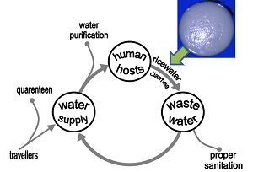
Notes:
Adequate preventative implementations can be applied and categorized into three phases regarding water treatment. These phases are water treatment and purification, water sterilization and sewage treatment. In the context of water purification, all of the water that is used for washing, cooking and drinking should be placed through ebullition at a minimum. In addition, the water should undergo filtration and sterilization (CDC, 2015; Rosenberg, 1987).

Slide 5
Notes:
Water that has been consumed and its products should be properly disposed. This holds specifically true for communities where there have been outbreaks of cholera. It is suggested that everyone who has been in contact with the victims of the cholera outbreaks thoroughly wash at regular intervals with chlorine products and hot water. In addition, the sewage in the community should be treated for bacteria by means of the application of chlorine and other purifying substances (CDC, 2015; Rosenberg, 1987).

Slide 6
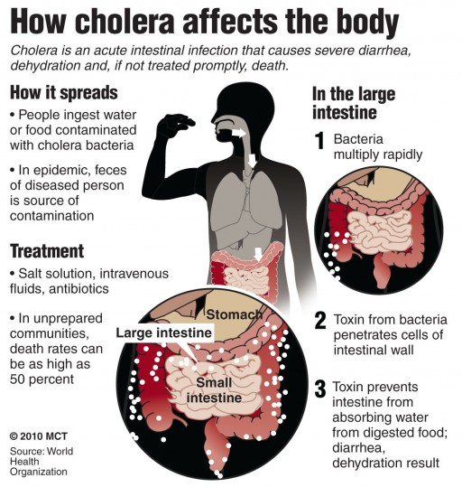
Notes:
Conclusion
Cholera is a highly communicable disease. The primary means of transmission of cholera are thorough water and food. In order to minimize the potential for the spread of cholera, adequate water sanitation measures should be applied. In addition, anyone who has been in contact with cholera victims should wash with chlorine products and hot water. There are oral and intravenous vaccinations for cholera. The mortality rate for cholera that has been properly treated is less than one percent.

