Slide 1
Health Policy Presentation: HIV Screening
Name
Class
Professor
November 3, 2015

Slide 2
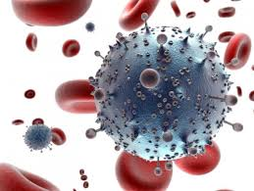
What is HIV?
HIV is the human immunodeficiency virus
It attacks the immune system of infected individuals, causing them to become sick easily (Douek et al., 2009)
As of 2014, there were 36.9 million people living with HIV (Ku,mar, 2012)

Slide 3
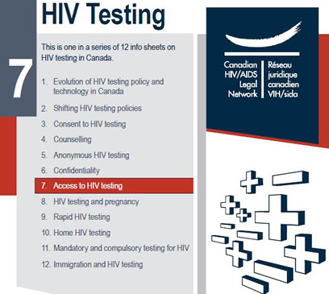
HIV Detection Initiatives
Approximately 1.3 million die from HIV-induced AIDS each year
Many people with HIV are not aware of immune system damage until it is too late
Advanced screening for HIV can save thousands of lives each year

Slide 4
Type of Legislation
Currently, this HIV screening legislation is being implemented by NYC but it would be beneficial to expand it to the state and nation (Health NY, n.d.)
Specifically, this law was passed by NYC congress
This will influence nursing practice because it will allow us to provide patients with more comprehensive care

Slide 5
Review of the Literature
HIV is transmitted either sexually or through the sharing of needles (Weiss, 1993)
While there are treatments available for the disease, there is no cure (Gilbert et al., 2003)
HIV functions by slowing destroying the immune system (Levy, 1993)
Individuals with AIDs are more likely to die from common illnesses, such as the common cold

Slide 6
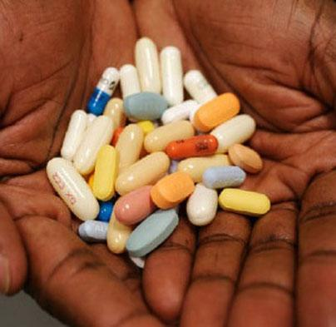
Possible Methods of Addressing the Issue
New York City currently requires that emergency departments ask every patient whether they would like to be screened for HIV
This initiative has increased the number of individuals that have access to detection methods
If more people are aware of their disease status, they are more able to receive immediate medical treatment and slow down the spread of HIV

Slide 7
Stakeholders
There are many stakeholders for this problem including:
Patients
Pharmaceutical companies
Pharmacies
Medical professionals
Friends and families of those with HIV
Future sexual partners of those with HIV

Slide 8
Risks and Benefits of Changes
More people will have access to HIV detection methods
The population will become more educated about HIV
Insurance companies will pay for these tests
HIV will be less likely to be unknowingly spread through the population
The uninsured will still have a difficult time accessing these tests

Slide 9
References
Douek DC, Roederer M, Koup RA (2009). Emerging Concepts in the Immunopathogenesis of AIDS. Annu. Rev., Med. 60: 471–84.
Gilbert PB, McKeague IW, Eisen G, Mullins C, Guéye-NDiaye A, Mboup S, Kanki PJ. (2003). Comparison of HIV-1 and HIV-2 infectivity from a prospective cohort study in Senegal. Statistics in Medicine, 22 (4): 573–593
Health NY. (n.d.). FAQ. Retrieved from https://www.health.ny.gov/diseases/aids/providers/testing/law/faqs.htm
Kumar, Vinay (2012). Robbins Basic Pathology (9th ed.)
Levy JA. (1993). HIV pathogenesis and long-term survival. AIDS, 7 (11): 1401–10.
Weiss RA. (1993). How does HIV cause AIDS?. Science, 260 (5112): 1273–9.

