Slide 1
Health Care Staff Shortage
Name
Class Professor
November 17, 2015

Slide 2
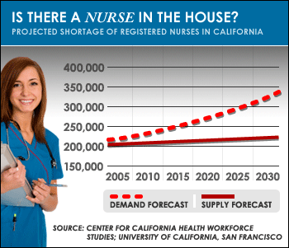
Nursing Shortage: Supply and Demand
As the population increases, the demand for nurses will continue to grow
However, a lack of interest in the profession, a shortage of qualified professionals, and the growing number of shorted contribute to the lack of a significant health professional supply
The disparity between supply and demand will increase over time

Slide 3
Pharmacist and Drug Shortage
As time continues, there will be a growing demand for pharmacists and a shortage of trained professionals
The role of pharmacists with regards to patient care is expected to expand
There is a greater need for pharmacists and less trained professionals per capita

Slide 4
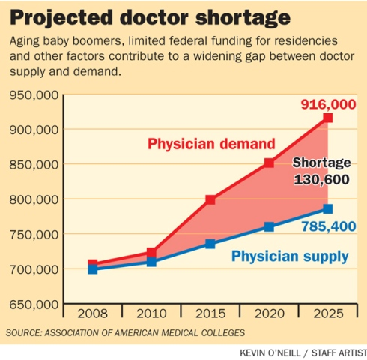
Physician Shortage
By 2015, there will be a need for 916,000 physicians even though there will only be 785,400 available
This shortage indicates that thousands of patients will not be able to see doctors or experience compromised care due to overcrowding

Slide 5
Addressing the Nursing Shortage
Hospitals should require shorter shifts of their nurses to help them avoid burnout
Medical program incentives can should be provided to students to help talented individuals that may not be able to afford nursing training to enter the field

Slide 6
Addressing the Pharmacist Shortage
Hiring pharmacy technicians and other assistance will release the strain placed on pharmacists
Pharmacists should be required to focus on their main job duties and not additional health practices
Educational programs can be used to help students understand pathways to becoming a pharmacist

Slide 7
Addressing the Physician Shortage
Addressing the physician shortage is arguably the most challenging because physicians require the greatest amount of training
Increasing the amount of combined BS/MD programs will quickly allow new and talented physicians to enter the workforce

Slide 8
References
AACN. (2014). Nursing Shortage. Retrieved from http://www.aacn.nche.edu/media-relations/fact-sheets/nursing-shortage
Ward, R. (2012). NEPA headed for deeper doctor shortage. Retrieved from http://thetimes-tribune.com/news/nepa-headed-for-deeper-doctor-shortage-1.1391496
Zurawski, D. (2015). The Ripple Effect of Drug Shortages. Retrieved from https://kitcheck.com/2015/02/ripple-effect-drug-shortages/

