Slide 1
Notes:
The topic of the presentation is the causes of hepatitis C. The means by which it is communicated were detailed. The potential for mortality was reviewed. The symptoms manifesting the disease were also discussed.

Slide 2
Notes:
Hepatitis C is designated as being a silent killer. Hepatitis C is a viral disease that is the causal attribute of liver inflammation. Hepatitis C is a category of virus which includes hepatitis A and hepatitis B. Each of the hepatitis virus categories manifest distinct behaviors and have distinct modes of communication (Gallin et al., 2000; Turkington, 1998).

Slide 3
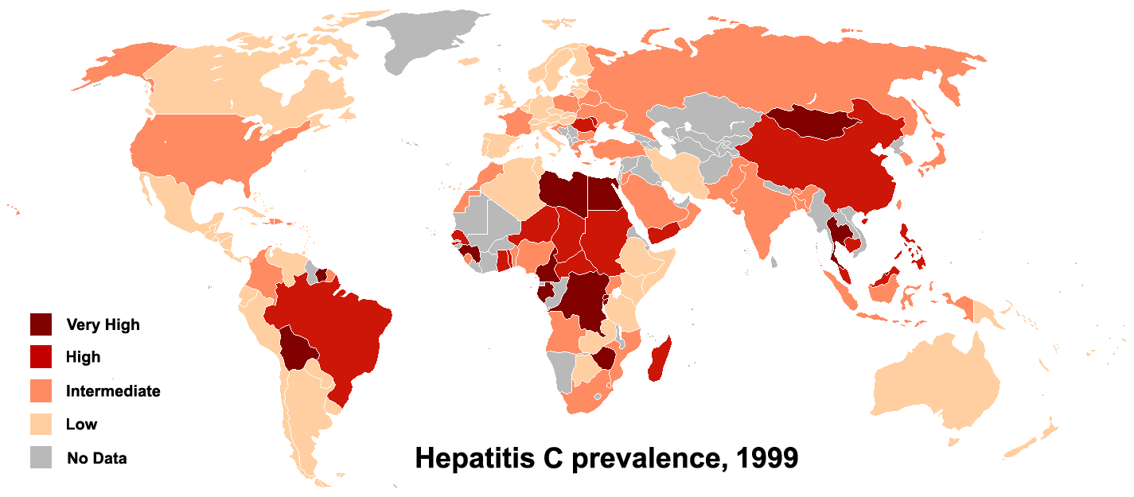
Notes:
Presently, there is no vaccine that can be ingested in order to avoid contracting the hepatitis C virus. Scientists continue trying to find a vaccine and a cure. There are presently vaccines that can be ingested for hepatitis A and hepatitis B. In order to decrease the peril of infection, personal items which include razors and toothbrushes should not be shared. Avoid the consumption of injected drugs. The acquiring of body piercings and tattoos pose a greater risk for contracting hepatitis C (Gallin et al., 2000; Turkington, 1998).

Slide 4
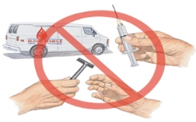
Notes:
Conclusion
Hepatitis C can be transmitted by coming into contact with the bodily fluids of someone who is infected. The most common manner of contracting hepatitis C is by means of an aperture in the skin. The opening that are caused by wounds are the most frequent means of transmission. The sharing of personal items which may have blood (i.e., needles, razors, toothbrushes) may also be a manner of transmitting the disease. There are no vaccines that are available in order to deter the spread of hepatitis C. The most effective manner of avoiding contracting hepatitis is to be aware of the manner by which it can be transmitted.

