Slide 1
Roc Nation LLC
Name
Class
Professor
October 31, 2015

Slide 2
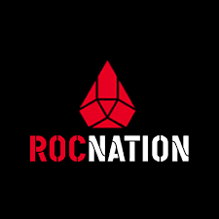
Company Background
Roc Nation LLC was founded by Jay Z in 2008
The company manages Kanye West, Coheed and Cambria, Shakira, and Rihanna
The organization has formed partnerships with Live Nation, Sony Music, and Universal Music
The yearly net worth of the company is $520 million
Technology is an important component of the company’s success; social media is used for marketing and the latest recording equipment are used for production and promotions
Notes:
Roc Nation LLC was founded by Jay Z in 2008. The company manages famous artists including Kanye West, Coheed and Cambria, Shakira, and Rihanna. Jay Z also uses the organization to manage and publicize his own music. The organization has formed partnerships with Live Nation, Sony Music, and Universal Music, allowing the company to extend its reach. Even though the company is just seven years old, the yearly net worth of the company is $520 million. Technology is an important component of the company’s success; social media is used for marketing and the latest recording equipment are used for production and promotions.

Slide 3
Products and Services
Roc Nation LLC offers a comprehensive list of services including songwriting, producing, engineering management, music publishing, touring and merchandising, and film and television
Roc Nation Sports is an additional effort of the company to extend their publicity services to boosting the reputation of athletes
Notes:
Roc Nation LLC offers a comprehensive list of services including songwriting, producing, engineering management, music publishing, touring and merchandising, and film and television. Roc Nation Sports is an additional effort of the company to extend their publicity services to boosting the reputation of athletes, although a majority of its services are focused on enhancing the popularity of musicians.

Slide 4
Revenue Streams
The artists pay Roc Nation LLC directly for their services
The cost of services depends on the particular services desired
Third party agencies will also pay Roc Nation LLC on the behalf of their artists
Notes:
The artists pay Roc Nation LLC directly for their services. The cost of services depends on the particular services desired. Third party agencies will also pay Roc Nation LLC on the behalf of their artists. This form of revenue stream is relatively simplistic because it allows the company to be directly paid for the services it provides.

Slide 5
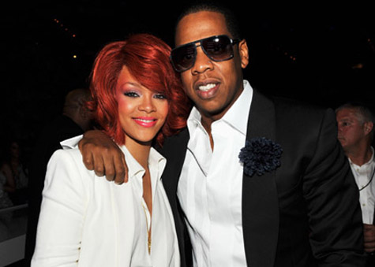
Competition and Evaluation
Competitors of Roc Nation include many other music promoting companies
However, Roc Nation is able to promote itself effectively because of its positive reputation
This organization is primarily recommended for only individuals that have a large sum of money for promotional purposes and have already achieved a degree of fame
The technology services provided by the company are of high value, so it is recommended for members of the public if they are seeking high end services
Notes:
Competitors of Roc Nation include many other music promoting companies. However, Roc Nation is able to promote itself effectively because of its positive reputation. This organization is primarily recommended for only individuals that have a large sum of money for promotional purposes and have already achieved a degree of fame. The technology services provided by the company are of high value, so it is recommended for members of the public if they are seeking high end services.

