Slide 1
Take Home Naloxone
Name
Class
Professor
November 4, 2015

Slide 2
Statement of the Problem
Population:
Emergency department patients treated successfully for opiate overdose.
Intervention:
The use of take home naloxone.
Comparison:
The use of take home naloxone compared to no take home naloxone.
Outcome:
The number of repeat overdoses and the number of subsequent overdose deaths.
Time:
A six-month period.
Notes:
The proposed study will examine emergency department patients treated successfully for opiate overdose. The selected intervention to be studied is the use of take home naloxone. Groups that are provided take home naloxone will be compared to those that are not provided with take home naloxone in an attempt to determine the difference in survival between the two groups. Specifically, the number of repeat overdoses and the number of subsequent overdose deaths will be examined over a six-month period.

Slide 3
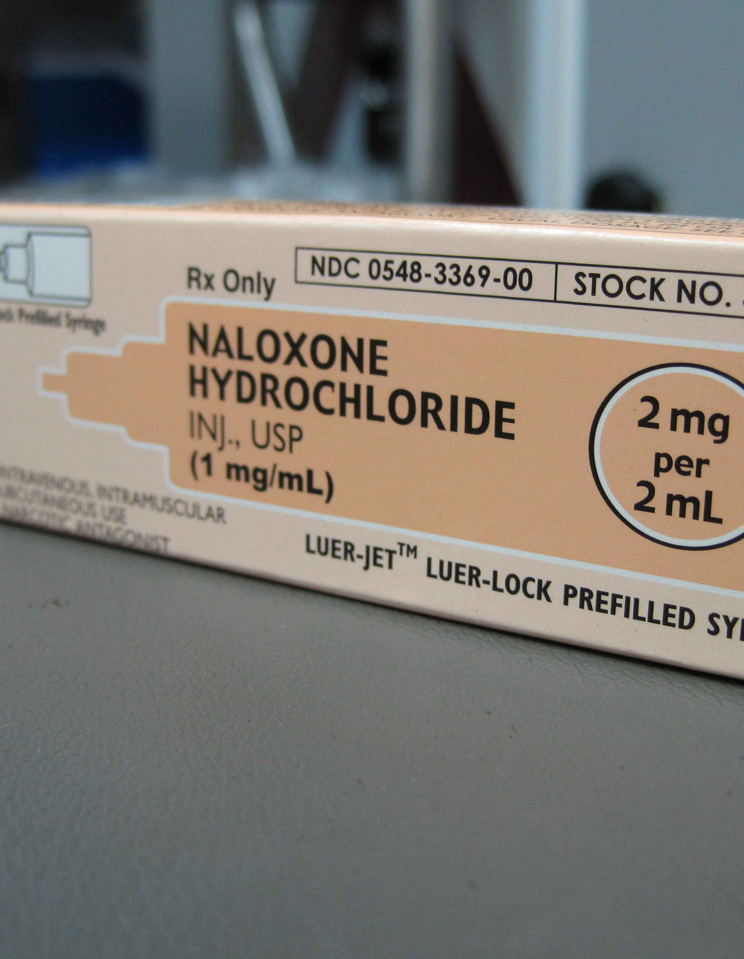
Background: What is naloxone?
Naloxone is best known for its ability to reduce the damaging effects of opioid medication (Beletsky et al., 2012)
Opioids are used for both medical and recreational purposes (CDC, n.d.)
Specifically, the drug helps reverse drowsiness, slowed breathing, and loss of consciousness, which contributes to its life saving effects (Roberts et al., 2014)
Google Images
Notes:
Naloxone is best known for its ability to reduce the damaging effects of opioid medication. Opioids are used for both medical and recreational purposes. Opioids are medications that are used to relieve pain, although they are also used as recreational drugs. Opioids were first isolated from the poppy plant, but much of the drugs used today are synthetic versions. Naloxone helps reverse drowsiness, slowed breathing, and loss of consciousness, which contributes to its life saving effects. Many emergency room professionals use this drug to treat overdoses, reducing the frequency of deaths due to opioid use in the population.

Slide 4
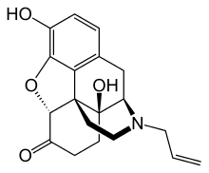
Background: Chemical Structure of Naloxone
The chemical structure of naloxone allows it to interact with the opioid receptor in the body
Naloxone is considered a opioid antagonist (Clark et al., 2014)
This chemical was derived from thebaine, also known as codeine methyl enol (Roberts et al., 2014)
Google Images
Notes:
The chemical structure of naloxone allows it to interact with the opioid receptor in the body. Naloxone is specifically considered a opioid antagonist. This chemical was derived from thebaine, also known as codeine methyl enol. These properties are what provide naloxone antagonistic effects

Slide 5
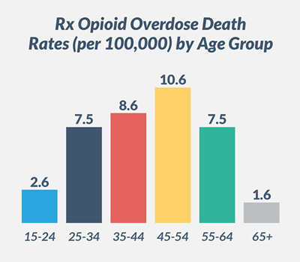
Background: Prescription Opioid Overdose
CDC.gov
Notes:
Overdose from using prescription opioids are common. More than 44 people die from such an overdose each day in the United States. This graph shows the age distribution of the individuals who have died from overdose between 1999 and 2013. The most deaths occur in individuals ages 45-54, who are most likely to be prescribed an opioid. Members of the young population, however, 15-24 are more likely to experiment with the drug for non-prescription use. Take home naloxone could potentially reduce deaths in these various categories.

Slide 6
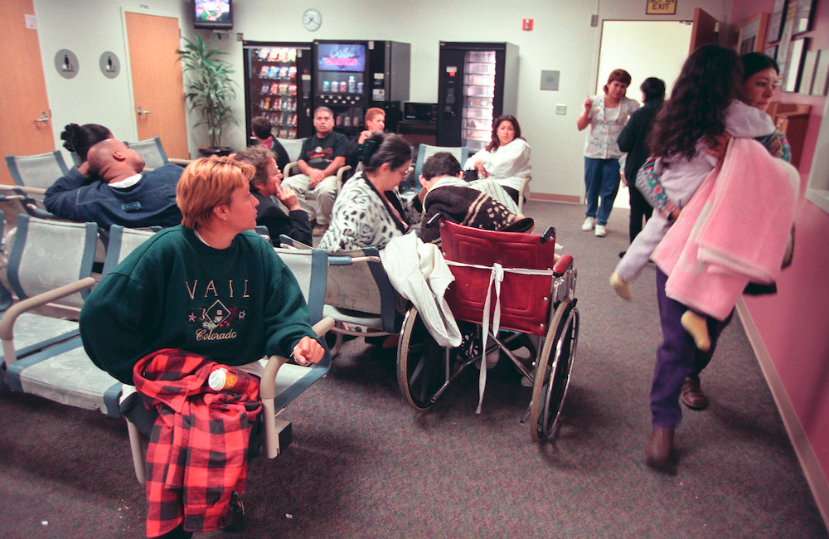
Background: Who needs naloxone?
Google Images
Notes:
Almost anyone can need naloxone if they are taking prescription opioids or are experimenting with the drug. Opioids can be damaging if they are taken contrary to physician instructions. This is especially problematic in areas with large cities in which the number of individuals likely to overdose are at an all time high. To make sure medical professionals are able to spend adequate time with each patient, providing them with take home naloxone could reduce the threat they will suffer if they are not provided with medication in a timely manner. Waiting areas are typically crowded and preventing access to naloxone could be life-threatening if individuals are not triaged properly.

Slide 7
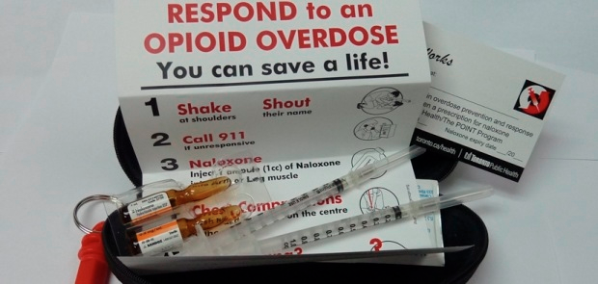
Background: Administering Naloxone
Bowman et al., 2013
Notes:
Naloxone is typically administered by medical professionals. However, it is easy to administer this product by following simple instructions. According to the information provided in this medication case, it is important to shake, shout, call 911, and then administer the naloxone. Ensuring that an individual receives medical treatment before the authorities arrive can save a life. Take home naloxone would be easy to use and beneficial in situations in which patients are experiencing near death encounters.

Slide 8
Literature Review Article Identification
Notes:
To identify relevant peer-reviewed literature, the search terms “take home naloxone” were selected for a search using the PubMed database. A total of 58 relevant articles were identified. After identifying which articles have been published within the last 5 years, 29 articles were shown to meet this search criteria. Articles were selected for use if the full version of the article was available online and if the published content was derived from a peer-reviewed journal.

Slide 9
This article by Clark et al. presents a systematic review of the literature to assess community opioid overdose prevention and naloxone distribution programs (2014)
Notes:
This article by Clark et al. presents a systematic review of the literature to assess community opioid overdose prevention and naloxone distribution programs. Over 300 articles were analyzed to determine the current state of knowledge regarding naloxone and take home naloxone programs. The evidence found primarily that if patients are provided with naloxone, passersby will take the drug and help the victim use it. This contradicts the understanding that naloxone is hard to use. Furthermore, there is evidence showing that in the studies utilized, there was a 100% survival rate among patients using the drug and only 1 individual out of 2000 used it improperly. Thus, it is apparent that take home naloxone programs have been successful in a majority of the published literature.

Slide 10
Clark et al. Review Methodology
A score of 0 indicates that the specified quality element is missing, while a score of 1 indicates that the quality element is present
Notes:
To rate the quality of articles observed, the reviewed provided each article with a score of 0 to 1, with a 0 indicating that expected elements for accuracy were not present and with a score of 1 indicating that all expected elements were present. Scores of 0.5 indicated that half of the expected elements were present. In the end, scores were totaled for each article and the articles that received the highest scores were shown to reflect the highest degree of quality. Prior to this method, 33 articles were considered for full text screening. After implementing this screening method, a total of 19 were selected for inclusion in the study from the original 360.

Slide 11
Clark et al. Summary of Findings 1
Notes:
This summary table describes a total of six take home naloxone programs. Most training programs focused on overdose prevention and application of naloxone in the case of an overdose. The least successful boasts a 89% survival rate, while the remaining have a greater than 95% survival rate. Even though these research studies demonstrate varying degrees of success, it is important to consider that all show that lives can be saved through the use of take home naloxone programs.

Slide 12
Clark et al. Summary of Findings 2
Notes:
This summary table describes five additional take home naloxone programs. Secondary goals of these initiatives include hosting detox clinics, syringe exchange programs, educating active drug users, and providing ambulance services to active drug users. There is at least at 99% survival rate for patients involved in all of the programs discussed. Most notably, the programs were initiated in diverse areas, such as Chicago, Scotland, Toronto, and Los Angeles. This demonstrates that take home naloxone programs could potentially benefit people in communities across the world, not just those in the United States.

Slide 13
Clark et al. Summary of Findings 3
Notes:
Interestingly, as a majority of patients received knowledge of naloxone treatments and information to help them prevent overdose, they are significantly more likely to avoid an overdose or prevent overdose related death. In one case, the education and intervention programs put in place in New York City contributed to a survival rate of 83%, which is a significant difference in survival overall, but not as adequate as the changes seen in similar programs in other areas. It would therefore be valuable to consider the aspects of naloxone programs that can reduce efficacy in large urban populations. In spite of this evidence, however, it would still be beneficial to promote take home naloxone programs in any location in which improvement in survival is seen.

Slide 14
Clark et al. Summary of Findings 4
Notes:
All three of these studies focused on overdose prevention by educating patients about risk factors for overdose, recognizing or responding to overdose, and naloxone training. These studies were conducted over three distinct timeframes, showing that timeliness is not a factor in the efficacy of these programs. Furthermore, it is important to emphasize in the more than 5000 patients examined across these three research studies, the minimum survival rate was 98%. It would therefore be beneficial to translate the information learned from these studies directly into practice.

Slide 15
This systematic review by McAuley et al. presents a systematic to determine the type of intervention and survival rates among patients being treated for opioid use (2015)
Notes:
This article by McAuley et al. presents a systematic to determine the type of intervention and survival rates among patients being treated for opioid use (2015). It was found that for every 100 people who use drugs that are trained to use naloxone, approximately 9 people need to make use of this treatment each month. Since about 10% of the population needs to use this drug, it is reasonable to continue training overdose patients to use it in the future.

Slide 16
McAuley et al. Summary of Findings
Notes:
Overall, the researchers claim that the THN (take home naloxone) program is effective based on the efficacy of reversals observed. Since approximately 9% of the take home naloxone kits that are distributed are used, these programs have the potential to many lives. Most individuals are likely to use the take home kit in the first three months after it is given, although there remains a need to determine at what frequency these kits are used 3, 6, and 12 months following the training program in order to gain a better understanding of program needs.

Slide 17
This non-random retrospective cohort study by Doe-Simkins et al. presents an understanding of the individuals likely to utilize naloxone for treatment (2014)
Notes:
This non-random retrospective cohort study by Doe-Simkins et al. presents an understanding of the individuals likely to utilize naloxone for treatment (2014). The study focuses on examining whether overdose prevention education and naloxone distribution could reasonably reduce the number of patients that die from opioid overdose. Among the 5000 drug user profiles analyzed, 295 trained individuals and 78 untrained individuals were able to contribute to rescues. This demonstrates that trained naloxone users are more likely to apply this drug to save lives, and even those who do not receive formal training are capable of doing so. It is likely that a large discrepancy was seen between trained and non-trained individuals because the trained individuals were more confident about applying the drug.

Slide 18
Doe-Simkins et al. Summary of Findings
Notes:
7.6% out of the 4926 substance users reported that they had administered naloxone during an overdose rescue. While the researchers claim that there was few differences between trained and untrained users, this does not appear to be the case in reality. It is important to determine the dose-dependent effect of training on the tendency of an individual to respond during emergency situations in addition to their ability to access naloxone in the case of emergency. It is likely that the more training an individual receives with regards to the use of naloxone, the more confident they will be to use it in emergency situations. It is necessary to increase the confidence level of individuals to use the drug because doing so can save lives.

Slide 19
Literature Review: Current Knowledge and Gaps
Naloxone saves lives (Clark et al., 2014)
There have been very few randomized trials to analyze the efficacy of take home naloxone programs (McAuley et al., 2015)
There is a need to determine the outcome that take home naloxone programs will have on the population (Clark et al., 2014)
Providing additional training naloxone programs can potentially increase the confidence that substance users have to apply this treatment (Doe-Simkins et al., 2014)
Notes:
Naloxone saves lives. There have been very few randomized trials to analyze the efficacy of take home naloxone programs. There is a need to determine the outcome that take home naloxone programs will have on the population. Providing additional training naloxone programs can potentially increase the confidence that substance users have to apply this treatment.

Slide 20
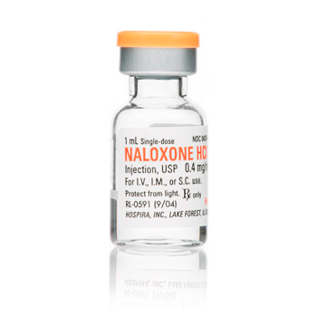

Comparison of the Literature
Naloxone acts within 5 minutes (CDC, n.d.)
By standards can provide individuals with a second dose of the medication to improve the odds that the patient will wake up (Bowman et al., 2013)
There is a reported 95% success rate associated with the use of this drug (Hamilton et al., 2013)
Some critics believe that naloxone take home programs would not be effective due to the effects that misuse could cause (Yardley, 2013)
Notes:
Naloxone acts within 5 minutes. By standards can provide individuals with a second dose of the medication to improve the odds that the patient will wake up. There is a reported 95% success rate associated with the use of this drug. Since naloxone is highly effective, this drug is the preferred choice of medical professionals. Some people are worried that allowing patients to take this drug home will result in adverse effects. For example, some may misuse the needle and inject air into their veins. In other cases, they may pass out before the use of the drug is applicable. However, it makes it easier for medical professionals to understand a patient’s problem when they find that they are carrying the drug. EMTs can immediately arrive on the scene and apply it. Furthermore, risk is reduced when patients are taught how to use the drugs themselves before its provided. Overall, there is a greater risk of death for not giving the drug than there is prescribing it with careful regulation. Many people around the world owe their lives to naloxone.

Slide 21
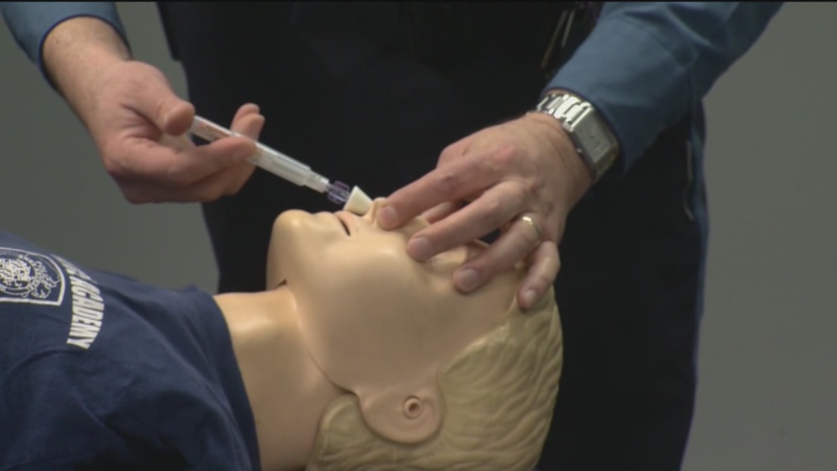
Clinical Expertise and Patient Preference: Training the Public About Naloxone
Google Images
Notes:
According to the AHRQ, “ Substance abusers experience traumatic injuries (see section on Patients with Shock, Trauma, and Burns) and a variety of health problems more often than the general population (AHRQ, 1992)” Thus, it is important to enhance education about members of this population to prevent them from receiving trauma to the brain during an overdose. To increase the efficacy of take home naloxone programs, it would be beneficial to raise awareness about opioid overdoses and provide training to civilians to help naloxone carriers experiencing an overdose. Just as civilians use CPR to help save the lives of strangers, they will be able to help save the lives of opioid users. Awareness is the main key to the success of this formula. It is important to consider the patients during this practice change. Allowing the use of take home naloxone will not only save lives, but spread awareness about opioid overdose and contribute to the development of a more supportive environment for patients who are typically stigmatized for this problem.

Slide 22
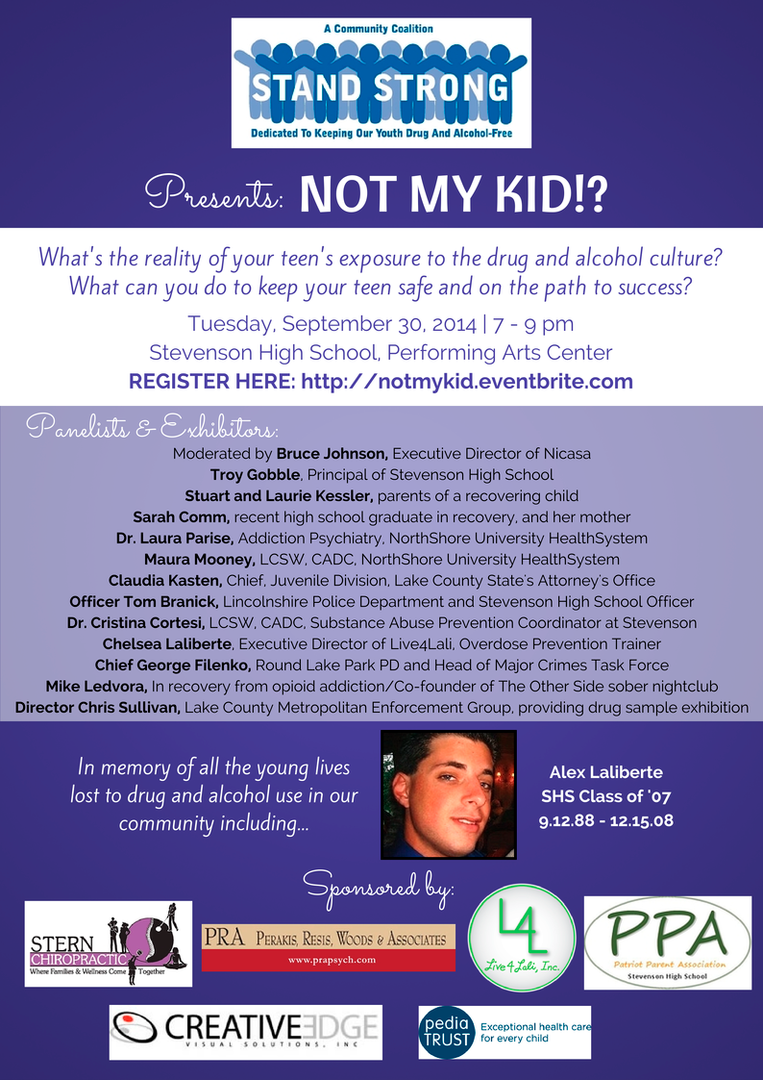
Application to Practice: Naloxone Education Programs
Google Images
Notes:
Nurses can contribute to this need by providing their patients with information about opioid overdose in populations that have high risk for this occurrence. It would be beneficial to provide this individual with a comprehensive understanding of naloxone application so that he or she can retrain friends and family members that are most likely to be nearby during an overdose. Predicting what will happen is the best way of preventing an unnecessary death. Many people believe that their loved ones cannot possibly be drug users, but it is important for these individuals to see the reality of tis situation.

Slide 23
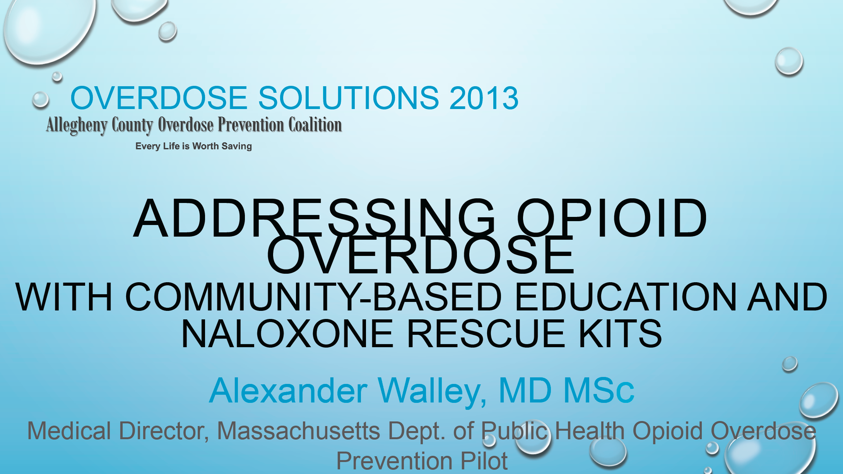
Application to Practice: Establishment of Take Home Naloxone Programs
Google Images
Notes:
As deaths related to opioid use increase, there is a growing concern as to what can be done about this problem. Many physicians and local interest groups understand the rationale behind naloxone take home programs and are determining how to spread relevant knowledge to the community.

Slide 24
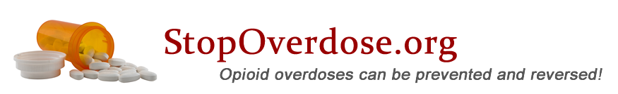

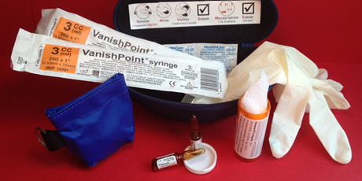
Application to Practice: Where to Get Information
Google Images
Notes:
An overwhelming number of websites are forming to help opioid users and their loved ones determine how to get help. Sites such as stopoverdose.org provide a comprehensive list of locations that naloxone can be retrieved from. In addition, they provide information about overdoses, how to avoid them, and how to help individuals in need. Many different versions of these websites are available for individuals living in different communities around the country.

Slide 25

Evaluation: How Nurses Can Help
Google Images
https://www.change.org/p/iowa-state-house-pass-sf410-to-save-lives-narcan-is-the-overdose-antidote
Notes:
It is important for nurses to remain involved in patient advocacy. Promoting the idea of take home naloxone programs to the hospital or writing to political leaders are reasonable ways of advocating for the cause. Furthermore, nurses and other medical professionals can help implement special educational events for the community and implement this important knowledge in their personal practice. Furthermore, observing statistics related to reduction of death rate or hospital readmission following this policy will indicate a success. Outcomes can easily be evaluated by tracking patients with previous opioid overdoses to determine what their outcomes will be in the future. Nurses can become involved in promoting take home naloxone in part by promoting online petitions for its use, such as the one available here: https://www.change.org/p/iowa-state-house-pass-sf410-to-save-lives-narcan-is-the-overdose-antidote

Slide 26

Evaluation: Additional Steps
Google Images
Nurses could provide patients with information about naloxone use and take home programs
Determining the impact of these practices can help create feedback to improve both take home naloxone programs and related education programs
Organizations such as the Drug Policy Alliance have fact sheets available that can be distributed to patients
Notes:
Nurses could provide patients with information about naloxone use and take home programs. Determining the impact of these practices can help create feedback to improve both take home naloxone programs and related education programs. Organizations such as the Drug Policy Alliance have fact sheets available that can be distributed to patients.

Slide 27
Evaluation: Future Research Questions
Which aspects of populations minimize the efficacy of take home naloxone programs?
How long does it take before naloxone use becomes necessary?
How often should naloxone education programs be provided?
Notes:
The Clark et al. discussion of the success of the take home naloxone program demonstrated the lowest success rate among the 19 studies examined. Therefore, it would be valuable to determine what was different about this population that did not allow this program to be as successful as its counterparts in other cities. Next, it is essential to determine how frequency take home naloxone is within the year following the time in which training is provided. This will help medical professionals understand how frequently naloxone training programs should be provided.

Slide 28
Conclusion
Naloxone is 95% effective
It is easy to use
44 people die each day of opioid use
How many people can naloxone save even within a single day?
Notes:
Overall, naloxone is 95% effective, it is easy to use, and 44 people die each day of opioid use. So How many people can naloxone save even within a single day? Even though the answer is not yet clear we know that naloxone could be used to save lives. We must now gain scientific knowledge to determine how we can improve the naloxone take home programs and contribute to this goal.

Slide 29
References 1
AHRQ. (1992). Acute Pain Management: Operative or Medical Procedures and Trauma. Retrieved from http://www.ncbi.nlm.nih.gov/books/NBK52153/
Beletsky L, Rich JD, Walley AY (2012). Prevention of fatal opioid overdose. JAMA, 308(18): 1863–4.
Bowman S, Eiserman J, Beletsky L, Stancliff S, Bruce RD (2013). Reducing the health consequences of opioid addiction in primary care. Am. J. Med., 126(7): 565–71.
CDC. (n.d.). Prescription Opioid Overdose. www.cdc.gov
Clark, AK, Wilder, CM, Winstanley, EL. (2014). A Systematic Review of Community Opioid Overdose Prevention and Naloxone Distribution Programs. J Addict Med, 8(3).

Slide 30
References 2
Doe-Simkins M, Quinn E, Xuan Z, Sorensen-Alawad A, Hackman H, Ozonoff A, Walley AY. (2014). Overdose rescues by trained and untrained participants and change in opioid use among substance-using participants in overdose education and naloxone distribution programs: a retrospective cohort study. BMC Public Health, 1(14): 297.
Hamilton, Richard J. (2013). Tarascon pocket pharmacopoeia : 2014 classic shirt-pocket edition (28 ed.). Sudbury: Jones & Bartlett Learning.
McAuley A, Aucott L, Matheson C. (2015). Exploring the life-saving potential of naloxone: A systematic review and descriptive meta-analysis of take home naloxone (THN) programmes for opioid users. Int J Drug Policy. 2015 Oct 1. pii: S0955-3959(15)00306-0
Roberts, James R. (2014). Roberts and Hedges' clinical procedures in emergency medicine (6 ed.). London: Elsevier Health Sciences.
Yardley, W. (2013). Jack Fishman Dies at 83; Saved Many From Overdose. The New York Times. Retrieved from http://www.nytimes.com/2013/12/15/business/jack-fishman-who-helped-develop-a-drug-to-treat-overdoses-dies-at-83.html?_r=0

