Slide 1
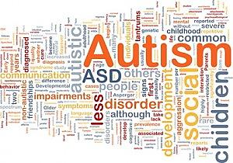
The Ziggurat Intervention Program
Supporting the Needs of Children with Autism Spectrum Disorder

Slide 2
What Learning Disorders are About
Each child is special
Every student adapts to a specific learning process
There are individuals who require more time to develop compared to others
There are those who require more attention and concentration to
understand what
they are being taught .
Notes:
In the field of modern education, considering learning disabilities is already a common ground of understanding for instructors especially that of the special education teachers. Knowing the different cases of learning disorders allows teachers to handle learning difficulties more effectively.

Slide 3
Understanding Autism Spectrum Disorder A) Behavioral Development
Does not easily respond to affectionate touch from parents or from relatives
Avoids too much connection with peers even when at play
Prefers being alone because the child cannot fully adjust to others surrounding him
Does not fully recognize the
need to care for others’
feelings
Notes:
Individuals with autism spectrum disorder often find it hard to learn because they have imbalance in behavioral development especially in relation to the process of creating a more defined indication of connection with others. Preferring to be on their own, they usually focus only on what they want and not what they are supposed to learn from class.

Slide 4
Understanding Autism Spectrum Disorder A) Learning Procedures
Develops language adaptation later than age 3
Has an odd tone or rhythm when speaking
Follows the words spoken but does not develop any comprehension on them
Develops learning stimulation problems and has extremely irritably attitude towards noise, light or the slightest change
of mood or environment.
Notes:
Young children experiencing the symptoms of Autism Spectrum Disorder are challenged by the mere noise that is almost unavoidable in regular classrooms. The number of people surrounding them often stresses them out making it imossible for them to concentrate in class.

Slide 5
THE INTERVENTION
The intervention plan shown in the table provides a clear definition on how each aspect of learning difficulty that a child with Autism Spectrum Disorder is experiencing ought to be assisted through patient and focused process of teaching.
Notes:
In adapting the Ziggurat Intervention Process, it is important to focus on the child; making sure that what is given to him is what he really needs and not just what he needs to finish.

Slide 6
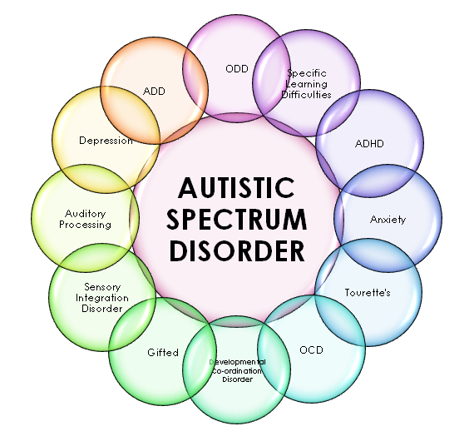
Setting Apart from Regular Schooling Center of Learning: THE STUDENT
In dealing with special cases such as Autism Spectrum Disorder, it is important to make sure that the child comes first above anything else. Not every student with ASD have the same pattern of learning either.
Although they may have similarities, it is always more helpful to consider the need of each child when it comes to learning as an individual and not as a mere person who is part of a known group .
Notes:
Setting the system of teaching apart between a child with ASD and a child who suffers another disability need not create a sense of discrimination in the classroom. Educators need to know that to eliminate some of the uneasy behaviors of the children, they have to know they are respected, accepted and considered as normal as other kids are.
The idea presented by the image suggests that an individual with ASD is somewhat a collection of all other difficulties in learning hence ought to be observed closely by educators if they do want to make a difference on the being of the child.

Slide 7
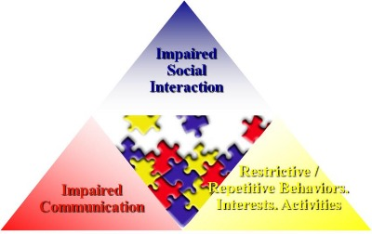
Setting Apart from Regular Schooling Core Curriculum: FOCUSED LEARNING
No STUDENT CAN TAKE EVERYTHING AT ONE SEATING…
This is especially true with students suffering from ASD.
-instructors need to plan ahead on what specific topic ought to be focused on within one seating….
-it is better to take one small step at a time and gain better results from the process later on.
Notes:
Given that learners with autism experience particular difficulties in different aspects of learning development, it is important to note that everything should be taken one step at a time. It does not matter how fast the child learns, what matters is how effective the lessons are and how well the child is able to grasp each lesson.

Slide 8
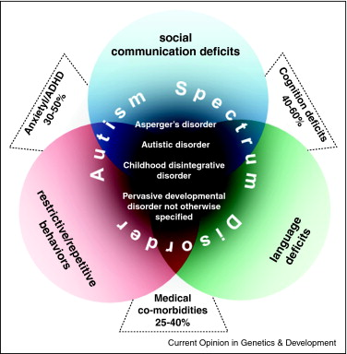
Setting Apart from Regular Schooling Core Process: DIVIDED INTERACTION ACTIVITIES
Given the condition of each child:
It is important to set apart times when the child is to mingle with peers
….and also when to set them apart as individual learners
This would lessen the tension of having the need to deal with others while also increasing their social capacities accordingly
Notes:
Divided interaction activities create a more conducive environment that is less stressful for most students. It could not be denied that through this process, the instructor would also have a better sense of control of the learning curriculum as well as the whole class [specifically pertaining to the young ones specific needs].

Slide 9
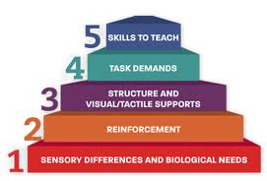
EXPECTATIONS FROM THE ZIGGURAT MODEL
Following the Ziggurat model of Intervention these expectations are being eyed:
-the child learns basic tasks and applies them in everyday activities
-the child learns how to work with peers with less stressed attitude
-while focus might be weak; it could be improved through learning schedules and activities taken one step at a time
-responding to tasks would be less pressuring for the child as he learns how to consider it as part of routine-learning
Notes:
The Ziggurat model follows the need to first deal with the sensory differences and the biological needs of each student;
Relatively, instructors who are able to understand this need are able to become more effective in dealing with learning changes that may occur among their students along the way

Slide 10
Technology and Learning
E-LEARNING and ENHANCEMENT OF STUDY THROUGH TECHNOLOGY
-each child benefits from modern technology as lessons presented through e-process are accustomed to their needs.
-ASD students would better gain progress in learning when specific e-systems of education are designed to help them understand their lessons in class.
-ASD students would have better chances at considering peer works when they are connected both offline and online.
Notes:
Computer technology has basically increased the competency of teachers in dealing with specific learning difficulties as activities are already done online and particular interactive programs are designed to make sure that they grasp their lessons at their own pace.

Slide 11
Improving Understanding through Technology
ENGAGING GAMES THAT ENGAGE PARENTS
Help well in providing the students with a differential option of learning that involves parental assistance.
Games or activities online that could ask for the involvement of the parents in the process makes it easier for the development of the students to be monitored and each learning curve to be assisted properly by individuals close to the young learner
Notes:
Involving others through technological assistance gives the learners a better sense of understanding how they are being assisted which usually creates a positive effect on the learning process embraced by each child.

Slide 12
Learning that is directed according to a student’s needs is one that sticks even to those who have the most compelling difficulties

Slide 13
References:
Schultz R. Developmental deficits in social perception in autism: The role of amygdala and fusiform face area. International Journal of Developmental Neuroscience. 2005;23(2–3):125–141.
Karst JS, Van Hecke AV. Parent and family impact of autism spectrum disorders: a review and proposed model for intervention evaluation. Clin Child Fam Psychol Rev. 2012;15(3):247–77.
Kanner L. Problems of nosology and psychodynamics in early childhood autism. American Journal of Orthopsychiatry.

