Slide 1
Ventricular Septal defect
Name
Class
Professor
November 16, 2015

Slide 2
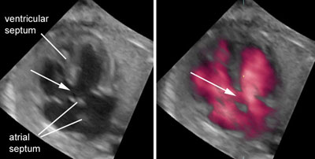
Definition of ventricular septal defect
Ventricular septal defect is defined as an opening in the dividing wall (septum) between the two lower chambers of the heart known as the right and left ventricles
The slight noise that is heard as a result of this opening is referred to as a “murmur”

Slide 3
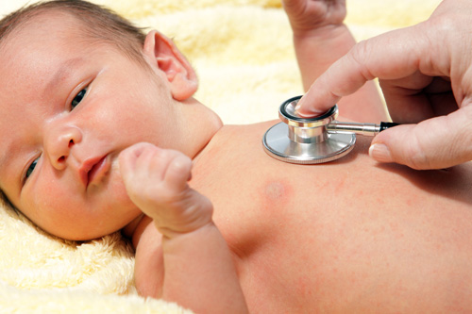
Population health statistics: Incidence
Congenital heart defects (CHDs) are the most common types of birth defects, with 40,000 babies in the United States born with this disease each year
25% of babies with CHDs, such as ventricular septal defect, require surgery within the first year of life (CDC, n.d.)

Slide 4
Population health statistics: Cost factors
Hospital costs for patients with ventricular septal defect (VSD) exceeded $1.4 billion in 2004 (CDC, n.d.)
It is expected that coverage for individuals with VSD will become more affordable under the Patient Protection and Affordable Care Act (PPACA)

Slide 5
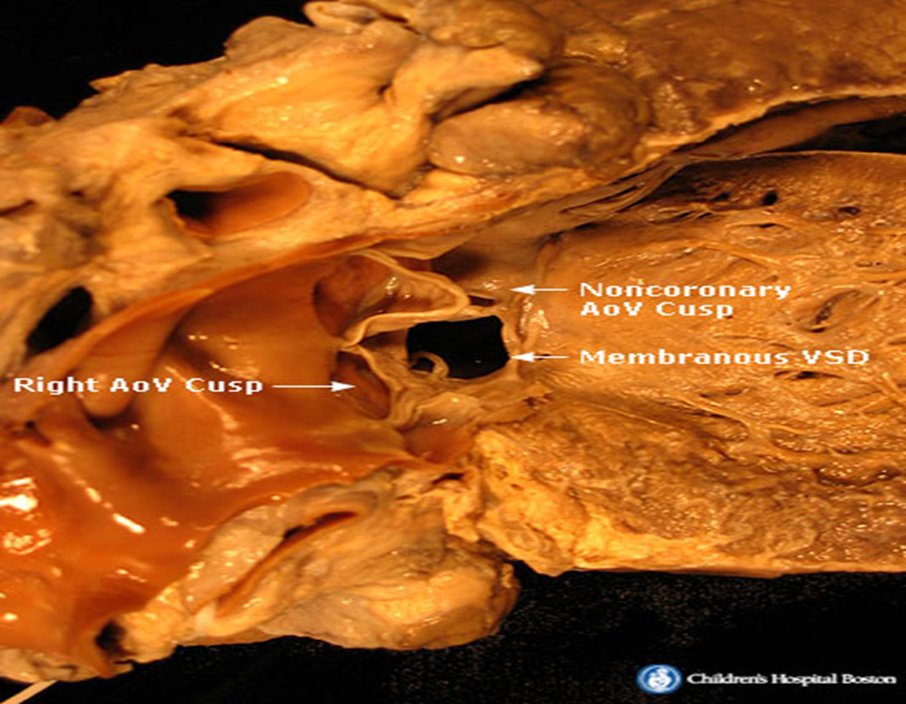
Impact on the cardiovascular system
In patients with VSD, blood can travel from the left pumping chamber in the left ventricle to the right pumping chamber in the right ventricle, and out into the lung arteries.
Extra blood being shunted into the lung arteries makes the heart and lungs work harder and the lungs can become congested

Slide 6
Impact on the respiratory system

Slide 7
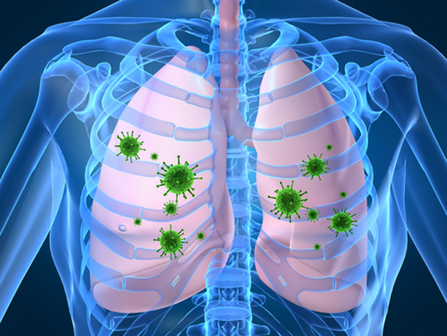
Impact on the respiratory system
Microbial infection of the respiratory system is an occasional side effect of VSD
Infection is frequently indicated due to surgery that is carried out on the pulmonary artery (Morrow et al., 1961)

Slide 8
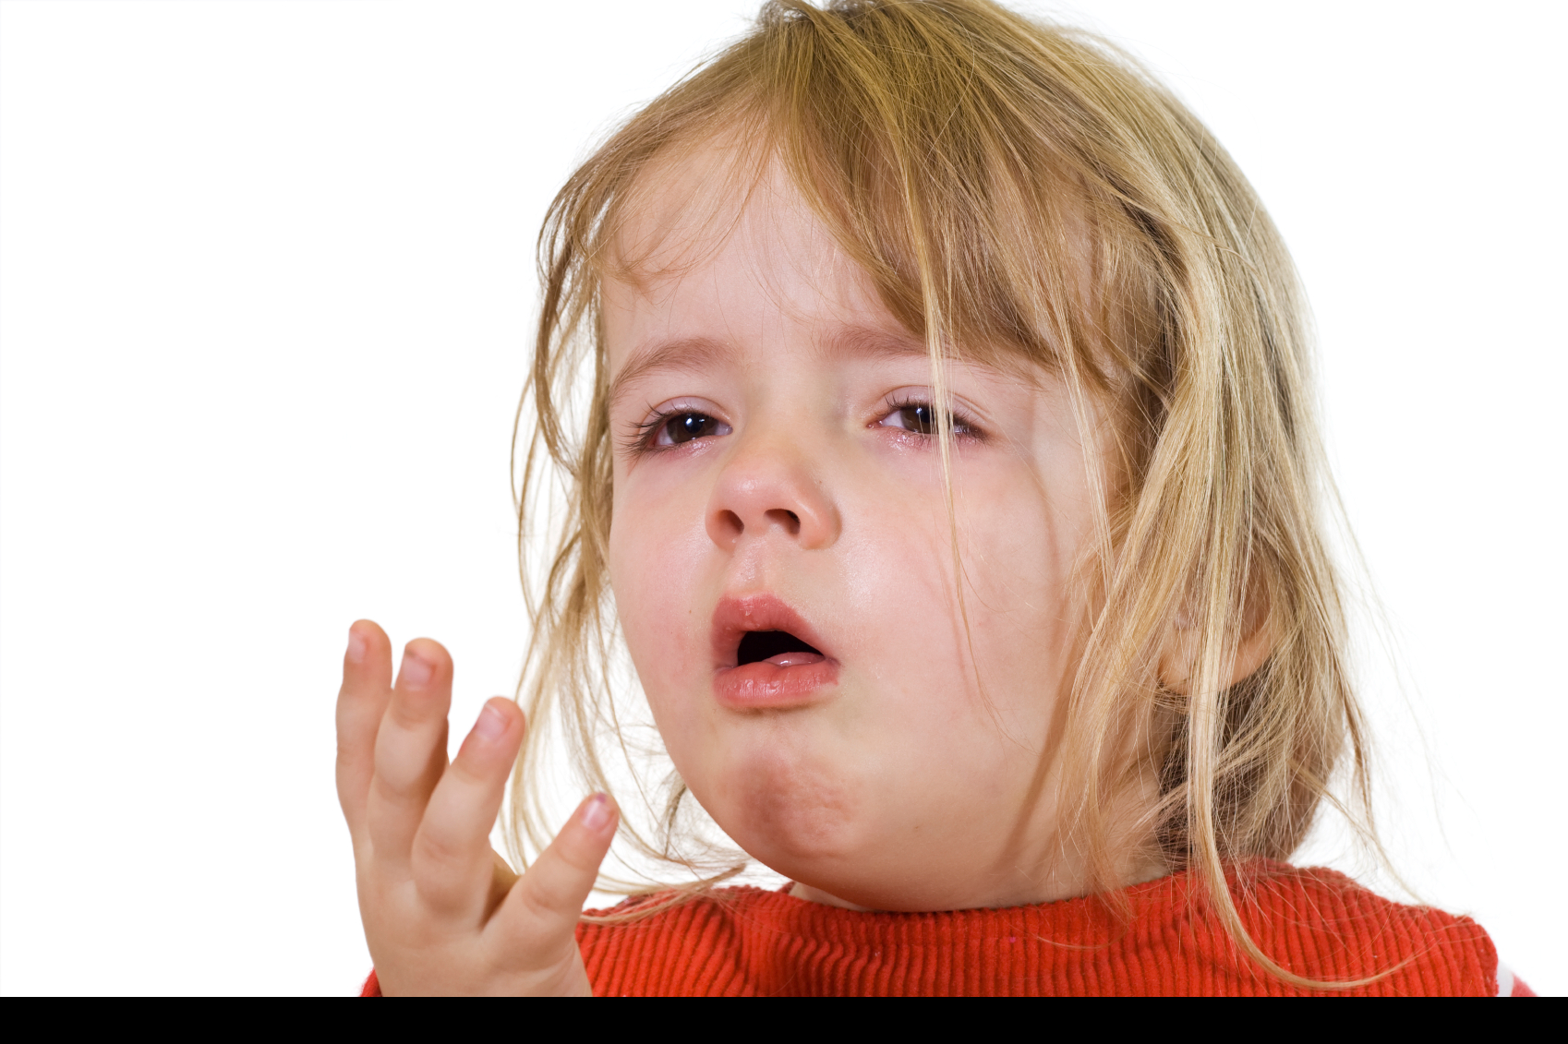
Impact on the respiratory system
Increased pulmonary venous pressure can increase pulmonary interstitial fluid
When this condition is severe enough, patients can present with pulmonary edema, congestion, and frequent respiratory infections

Slide 9
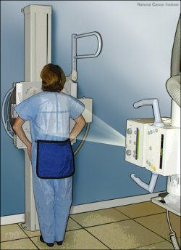
Diagnosis of ventricular septal defect
Chest x-rays are used to produces pictures of the heart and surrounding organs
Electrocardiograms (EKGs) record the electrical activity of the heart
Echocardiograms (echos) use sound waves to produce a picture of the heart and to visualize blood flow through the heart chambers
Cardiac catheterizations are used to provide information about the heart structures as well as blood pressure and blood oxygen levels within the heart chambers

Slide 10
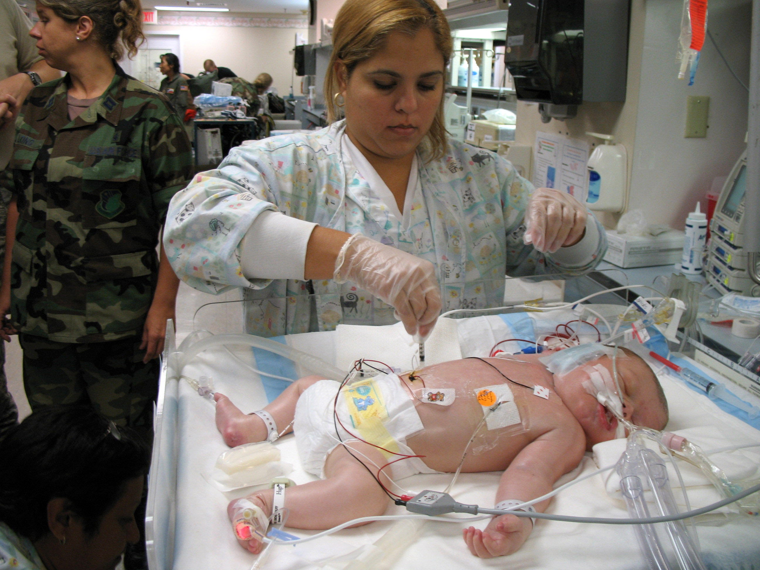
Respiratory therapies
Incentive spirometry: A medical device used to help patients improve the functioning of their lungs.
Chest physiotherapy: Striking the chest with a cupped hand or applying a vibrating device to the chest to loosen mucus.

Slide 11
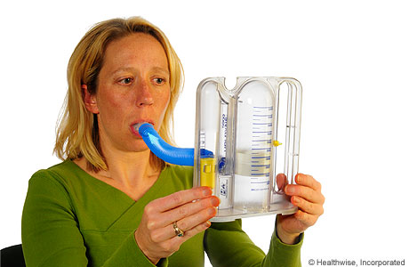
Respiratory therapies
Deep breathing exercises: Deep breathing helps to increase lung volumes and open up alveoli
Postural drainage: Positioning patients to help drain excess fluid or mucus out of the lungs

Slide 12
Role of the Respiratory therapist
The role of the respiratory therapist depends on the severity of the VSD
In extreme situations, the respiratory therapist may be responsible for:
Maintaining a patient's artificial airway, which may be in place to help the patient who cannot breathe through normal means
Operating and maintaining highly sophisticated equipment to administer oxygen or to assist with breathing
Employing mechanical ventilation for treatment of patients who suffer from lung failure
Monitoring and managing therapy that will help a patient recover lung function

Slide 13
Role of the respiratory therapists
Additional responsibilities include:
Obtaining and analyzing sputum and breath specimens
Taking blood specimens for analysis of oxygen, carbon dioxide, and carbon monoxide
Interpreting medical data
Measuring lung function
Performing stress tests and other studies of the cardiopulmonary system

Slide 14
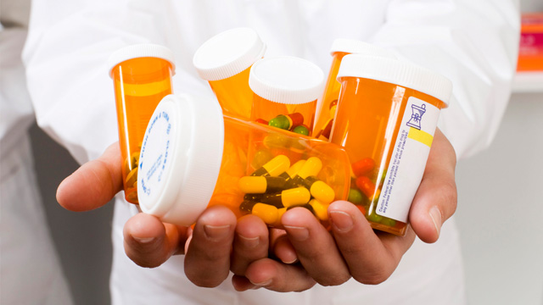
Treatments for VSD
As an alternative or supplementary strategy for surgery, medical professionals aim to:
Increase the strength of the heart's contractions
Decrease the amount of fluid in circulation and in the lungs
Keep the heartbeat regular

Slide 15
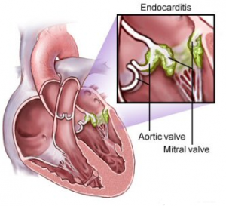
Long-term Prognosis
VSD creates an increased risk for infections of the heart walls and valves (endocarditis)
People with VSD will need to take antibiotics before dental procedures, including cleaning and other dental care, and before surgical procedures on the mouth or throat to avoid risk of infection

Slide 16
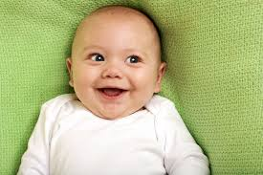
Long-term prognosis
If large ventricular septal defects are diagnosed and managed appropriately, a child with a ventricular septal defect can have a normal length of life with no restrictions
97% of infants with VSD survive beyond the first year (American Heart Association, 2015)

Slide 17
References
American Heart Association. (2015). Ventricular Septal Defect (VSD). Retrieved from http://www.heart.org/HEARTORG/Conditions/CongenitalHeartDefects/About CongenitalHeartDefects/Ventricular-Septal-Defect- VSD_UCM_307041_Article.jsp
CDC. (n.d.). Congenital Heart Defects (CHDs). Retrieved from http://www.cdc.gov/ncbddd/heartdefects/data.html
Morrow, A.G., Braunwald, N.S. (1961). The Surgical Treatment of Ventricular Septal Defect in Infancy. Circulation, 24: 34-40.

