Slide 1
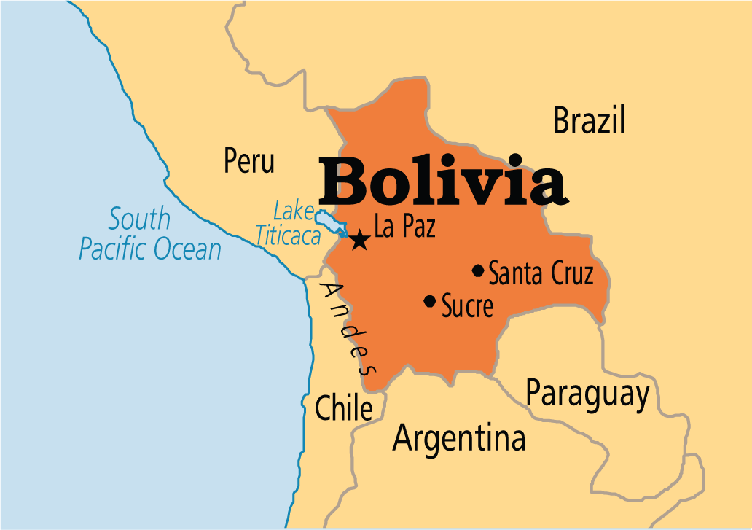
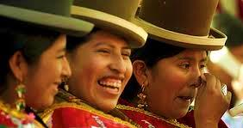
BOLIVIA’s Quest for Better Maternal Health and HIV Assessment
Under the Principles of Millennium Development Goals
Notes:
This presentation aims to follow through the principles of Millennium Development Goals or MDG so as to create a distinct form of operation that would better provide a good picture on how governmental administration actually handles the problem over Maternal Health and the rising risks related to women’s health

Slide 2
Women and
the Society
Every community relies on
the strength of women’s health.
Being the ones who bear the children, their health would determine the health of the whole society.
Investing in women’s health is investing on the community’s health in the years and
generations to come….
Protecting women’s health is included in
Bolivia’s Millennium Development Goals
Notes:
Every country deserves a fair share in incurring social growth. Bolivia, dubbed as one of today’s growing community, ought to be assisted in the manners by which it responds to modern healthcare challenges especially affecting the women. The country ought to invest upon these procedures as this would largely affect the future of the nation. Hence, the Bolivian administrator aims to address the said problems in order to improve the capacity of the nation to face the challenge of growth accordingly.

Slide 3
Current Issues of
Female Health in Bolivia
Bolivian women under the child-bearing age are smaller compared to the necessary height for conceiving a child. This increases the risk of giving birth to underweight infants.
Around 78% of these young women are noted to be anemic thus having less capacity to support the iron needs of a developing child during the pregnancy stage.
HIV cases among Bolivian women ranges from ages 15-24 hence increasing threat of the disease being passed on to the children.
Notes:
These problems create an alarming sense of attention that the administration needs to give specific consideration to in order to save the life of the women and the children they give birth to.

Slide 4
Presenting Solutions to
the Prevailing Problem
Increasing community education through community service operations
Providing better healthcare support system to women from ages 12 to 35 [including vaccinations and free prenatal checkups]
Establishing better forms of guidance for women as they handle being a mother and giving them better economic resource to support their new found responsibility
Notes:
The need to invest on the women of Bolivia shall save the government off from unnecessary amounts dedicated to healthcare operations that usually intend to respond to maternal complications before, during and even after birthing. This way, HIV Prevalence in the community could also be controlled accordingly.

Slide 5
Goals on Track for
Social Development
The target population in this development brought about change on how women’s health is being dealt with and how much attention they are getting from the government.
The capacity of the programs to provide efficient assistance to the community and to the women proved to be the strength of the agencies that are dedicated to reaching these goals accordingly.
Notes:
The need to invest on the women of Bolivia shall save the government off from unnecessary amounts dedicated to healthcare operations that usually intend to respond to maternal complications before, during and even after birthing. This way, HIV Prevalence in the community could also be controlled accordingly.

Slide 6
References:
Foundation for Sustainable Development. Bolivia. http://www.fsdinternational.org/devsubject/health/boliviaissues. (Retrieved on November 18, 2015)

