Slide 1
Women, Media, Sexual Assault, and Eating Disorders
Name
Class
Professor
November 21, 2015

Slide 2
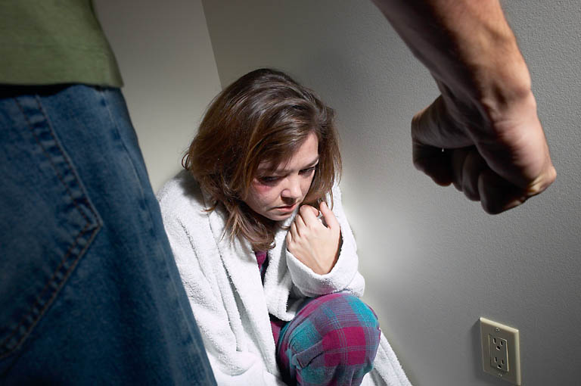
Introduction
According to the National Sexual Violence Resource Center “one in five women” will be raped in their lifetime and a total of “91% of victims of rape and sexual assault are female” (Mernissi, 2002)
90% of those diagnosed with eating disorders are female
29%-64% of women with eating disorders reported experiencing childhood sexual abuse and 11%-27% have been raped at some point in their lives (Harned & Fitzgerald, 2012)

Slide 3
Media Perpetuation of violence
When women have been violated and face emotional trauma following that sexual assault, their emotional strength and resilience becomes compromised, making them even more vulnerable to the pressure of the media
The media promotes the perpetuation of violence against women by showing it as a regular activity
The media on a woman’s already shattered esteem will likely assist in driving a woman to an eating disorder

Slide 4
Link between sexual assault and eating disorders
Emotional responses to sexual trauma and assault oftentimes result in eating disorders
When women have been violated and face emotional trauma following that sexual assault, their emotional strength and resilience becomes compromised, making them vulnerable to societal pressure
Women are not only dramatically more vulnerable to being victims of sexual assault, which has a small association with eating disorders

Slide 5
Key findings
“The effects of CEA on eating psychopathology were mediated entirely through anxiety and dissociation,” with anxiety being the stronger mediator (Kent et al., 1999)
Purging and fasting is a victim’s attempt at purification after the incident (Fairburn & Harrison, 1991)
Women are especially vulnerable to developing eating disorders due to their high chances of experiencing sexual trauma at some point in their lives; when a woman’s body is violated, her need to control her life might lead to the development of an eating disorder

Slide 6
Next Directions
Issue surveys to find a quantitative relationship between media and sexual assault
Use this information to determine quantitative relationship between sexual assault and eating disorder
Determine how to reduce the frequency of eating disorders and stress related to the media for victims of sexual assault

Slide 7
References 1
Bishop, M., Rosenstein, D., Bakelaar, S., & Seedat, S. (2014). An analysis of early developmental trauma in social anxiety disorder and posttraumatic stress disorder. Annals of General Psychiatry, 13(16), 1-13.
Dansky, B. S., Brewerton, T. D., Kilpatrick, D. G., & O’Neil, P. M. (1995). The national women’s study: relationship of victimization and posttraumatic stress disorder to bulimia nervosa. International Journal of Eating Disorders, 21(3), 212-228.
Dworkin, E., Javdani, S., Verona, E., & Campbell, R. (2014). Child sexual abuse and disordered eating: the mediating role of impulsive and compulsive tendencies. Psychology of Violence, 4(1), 21-36.
Fairburn, C. & Harrison, P. (2003). Eating disorders. The Lancet, 361(1), 407-416.
Fernàndez-Aranda, F., Pinheiro, A. P., Thornton, L. M., Berrettini, W. H., Crow, S., Fichter, M. M., . . . Bulik, C. M. (2008). Impulse control disorders in women with eating disorders. Psychiatry Research, 157, 147-157.

Slide 8
References 2
Harned, M. S. & Fitzgerald, L. F. (2002). Understanding a link between sexual harassment and eating disorder symptoms: a meditational analysis. Journal of Consulting and Clinical Psychology, 70(5), 1170-1181.
Holzer, S.R., Uppala, S., Wonderlich, S. A., Crosby, R. D., & Simonich, H. (2008). Mediational significance of PTSD in the relationship of sexual trauma and eating disorders. Child Abuse & Neglect, 32, 561-566.
Kent, A., Waller, G., & Dagnan, D. (1999). A greater role of emotional than physical or sexual abuse in predicting disordered eating attitudes: the roles of mediating variables. International Journal of Eating Disorders, 25(2), 159-167.
Root, M. P. P. (1991). Persistent, disordered eating as a gender-specific, post-traumatic stress response to sexual assault. Psychotherapy, 28(1), 96-102.
Shafran, R., Fairburn, C. G., & Cooper, Z. (1998). A cognitive behavioral theory of anorexia nervosa. Behavior Research and Therapy, 37, 1-13.
Statistics about sexual violence. (2015). National Sexual Violence Resource Center. Retrieved from http://www.nsvrc.org/sites/default/files/publications_nsvrc_factsheet_media-packet_statistics-about-sexual-violence_0.pdf
Statistics: how many people have eating disorders?. (2011). ANRED. Retrieved from http://www.anred.com/stats.html
Who are the victims?. (2012). Rape, Abuse, and Incest National Network. Retrieved from https://rainn.org/get-information/statistics/sexual-assault-victims

