Slide 1
Catheter- Associated Urinary Tract Infection
Name
Course name and Professor
Fall 2015

Slide 2
Objectives
To identify possible causes of catheter associated urinary tract infection
To relate developments in the science pertaining to catheter associated urinary tract infection
To outline some current measures being utilized in preventing catheter associated urinary Tract infection
Notes:
In this research catheter associated urinary tract infection prevention will be explored. There are recent studies revealing that catheter induced urinary tract infections are increasing. As such, healthcare professionals ask, what can be done to reduce the increase and prevent catheter induced infections entirely in nursing practice. With these increasing incidences healthcare research has been focused on studying causes and strategies, which can be used to facilitate better interventions during insertion and after care when catheters are inserted.
Many protocols have been established, but still this irregularity persists in clinical practice. Is this a nursing intervention dysfunction or are the catheters being used currently produce allergic reactions initiating these infections? For these concerns to be addressed a thorough investigation must be conducted. Studies will have to continue over a period of time to differentiate among possible causes. Identifying possible causes is the first step in preventing this problem. If a cause cannot be identified no preventative interventions could be effective. A total of six articles have been reviewed in trying to establish explanations for this irregularity and how it can be prevented in healthcare settings.

Slide 3
Background
Catheter associated urinary tract infections are the most common nosocomial infection in the healthcare industry
This accounted for 40% of all hospital infections annually
Less than 56% of hospitals in the US monitor incidences of urinary infections caused by catheters
74% of hospitals do not evaluate the length of time an indwelling catheter is inserted in a patient (Andreessen, Wilde & Herendeen, 2012)
Notes:
Literature has shown where catheter associated urinary tract infections are the most common nosocomial infection in the healthcare industry. This accounted for 40% of all hospital infections annually. Unfortunately, 56% of hospitals in United States of America do not have a system to monitor incidences of urinary infections caused by catheters. More importantly, 74% of hospitals do not evaluate the length of time an indwelling catheter is inserted in a patient (Andreessen, Wilde & Herendeen, 2012).

Slide 4
Background
720,000 catheter associated infections occur in the healthcare discipline annually
99,000 people die every year from CAUTI
This irregularity is linked to rising costs
9 million dollars are expended on treating catheter induced urinary tract infections every year
Notes:
Other sources have reported that there are as many as 720,000
Catheter associated infections in the heathcare discipline annually occurring in United States of America. An interesting development linked to this irregularity is the rising costs of care due to this abnormality. Some nine (9) million dollars are expended on treating catheter induced urinary tract infections in the country annually. Besides, of greater concern statistics show where in 2002 an estimated amount of 99,000 patients lost their lives due to catheter related urinary tract infections and its ensuring complication (Strouse, 2015).

Slide 5
Background
Catheter associated urinary tract infection is preventable
Cather associated Urinary tract infections are among the top 10 leading cause of death
This is an hospital acquired Infection
Center for Medicare has recognized CAUTI to the a very high malpractice liability
Notes:
The institute of Medicine in 1999 while admitting that to err is human has contended that catheter related urinary tract infections occurring in health care settings is a preventable medical error. Currently, it has because a huge challenge to healthcare safety. In addition when attempting to relate Medicare reimbursement to high quality care reduction and safety in the United States of America, the Department of Health and Human Services defined catheter induced urinary tract infection as an hospital acquired condition (Strouse, 2015).
Further data has revealed through Centers of Disease Control (CDC) that health care related infections have become one of the top ten (10) leading causes of death in United States of America. Seriously, these deaths and infections have are viable liabilities for medical malpractice cases. In acute care settings catheter associated infections are the most prevalent in this type of institutional care setting. Consequently, the Association for Professionals in Infection control and epidemiology has made statements regarding steps which ought to be taken in addressing this very sensitive healthcare issue, which has become a financial burden on the system and patients generally (Kahnen, Flanders & Magaong, 2011).

Slide 6
Possible intervention
Medical surgical nurses have a responsibility
They can and must prevent catheter associated urinary tract infections
Timely removal of catheters when no longer needed must be done
Educating patient care technicians and other healthcare professionals is mandatory
Monitoring of catheters after insertion is mandatory
Notes:
One such statement relates to responsibility of medical surgical nurses in ensuring that indwelling catheter care is conducted on patients who have to use them on a long term basis due to incontinence or any other reason. Evidence based practices regarding timely removal of indwelling catheters when no longer clinically needed was one of the first line approaches lidetowards controlling the infection. Another prophylactic intervention is monitoring the catheter insertion site for cleanliness to avoid growth of microorganisms. A third technique was training patient care technicians concerning catheter care when they have to be inserted in patients (Kahnen et.al, 2011).

Slide 7
Difficulties
Limited data on evidence proven causes
Conditions cannot be effective addressed if causes remain obscure
Advanced Practice Nurses and urologists’ should invest in research
There is limited research on catheter type relationship to CAUTI
Notes:
Despite the evidence that catheter associated infections are compromising healthcare quality still there is very little said in literature regarding the possible causes. My contention here is that we cannot prevent any condition from occurring if the causes are not revealed and clear. Therefore, advanced practice nurses engaged in research along with urologists ought to invest in more intense studies into reasons for catheter related infections in heathcare settings. It is true that catheters are foreign agents in the human body. However, how much research has been conducted regarding the impact of catheters on urinary tract infections? The independent variable guiding this proposition is catheter. Why then, is there not more investigations regarding the types of catheters introduced into the human body?

Slide 8
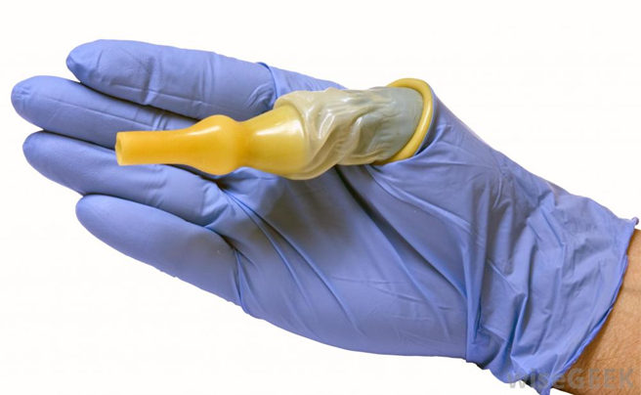
Possible Alternatives to cauterization
Employing urine retention relief techniques
Employing bladder toning restoration techniques
Conducting a thorough investigation for urine retention
Cauterization should be employed after all other alternatives have failed
Notes:
Butler (2011) advances that professional nurses can and must prevent urinary tract infections. This writer continues to emphasize the fact that professional nurses play an important role in urologic surgical preparation , especially, for bladder outlet obstruction procedures requiring catheterization. It was suggested that there are alternative measures professional nurses can take to relief urine retention other than a continuous drainage. These nursing techniques are as valuable in restoring bladder tone as indwelling catheters (Butler, 2011).

Slide 9
About catheters
30,000 catheters are being used in Healthcare across America yearly
System based interventions can affect catheter-associated urinary tract infection
For the majority of nursing home patients there is no alternative to catheterization
500,000 occur due to prolonged catheter insertion
Notes:
While these facts presented by Butler (2011) for the majority of bed ridden patients in nursing homes there is no other alternative to catheterization. How responsible are professional nurses in preventing those infections? Halm & O’Connor (2014) ask if system-based interventions affect catheter- associated urinary tract infections. They confirmed Dr. Frederick Foley recent studies findings that there is an estimated amount of 30,000 catheters being used in the healthcare industry across United States of America yearly. This being so an estimated amount of 500,000 related infections occur most of them being due to prolonged unnecessary use of catheters (Halm & O’Connor, 2014).

Slide 10
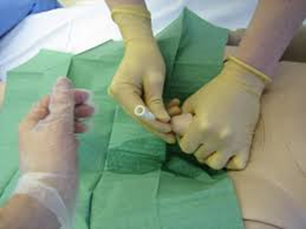
Results
DC catheters as soon as ordered by urologists to prevent infection
Massive education of staff on catheter care and usage indication
Establishing indication protocols
Do not insert indwelling catheters and leave unattended when not in use
Notes:
The authors explained that with respect to the etiology of prolonged use catheters systems could be adapted whereby indwelling catheters do not have to be inserted and left longer than necessary. Some measures are tagging the date catheters are inserted and removing them promptly when DC by the urologist. Besides, massive catheter education among staff was recommended with emphasis on catheter indication protocols for preventing unnecessary catheter insertions in clinical settings (Halm & O’Connor, 2014).

Slide 11
Summary
Length of time catheters are inserted is the major cause of CAUTI
Instituting mandatory catheter indication protocols proved effective
CAUTI is essentially a nursing intervention issue
Also CAUTI is a hospital related infection
Penalties ought to be introduced for prevention and control
Notes:
Bernard, Hunter & Moore (2012) conducted research and discovered that by reducing the length of time catheters are inserted is a valuable preventative measure for catheter associated urinary catheter infections. This coincides with Halm & O’Connor’s (2014) understanding of catheter related urinary tract infection prophylaxis. As such, in attempting to answer the question, Is this a nursing intervention dysfunction or are the catheters being used currently produce allergic reactions initiating these infections? The foregoing literature while suggesting that it is essentially a nursing intervention issue the major contributory factor lies in the length of time catheters are left in situ without being attended by nursing staff (Bernard, Hunter & Moore, 2012) (Halm & O’Connor’s, 2014). My recommendation, especially, for nursing homes where this irregularity is most prevalent is that regulations be made instituting penalties for catheters, which are left inserted unnecessarily.

Slide 12
References
References
Andreessen, L, Wilde, M., & Herendeen, P. (2012). Preventing Catheter-
Associated Urinary Tract Infections in Acute Care. J Nurs Care Qual 27(3); 209-
217
Bernard, M. Hunter, K., & Moore, K. (2012).A Review of Strategies to Decrease the
Duration of Indwelling Urethral Catheters and Potentially Reduce the
Incidence of Catheter-Associated Urinary Tract Infections. Urologic Nursing
32(1); 29 -32
Butler, T. (2011). Professional Nurses Can and Must Prevent Urinary Tract
Infections. The Oklahoma NurseHalm, M., & O’Connor’s, N. (2011). Do System-
based Interventions Affect Catheter Associated
Urinary Tract Infection. American Journal of Critical Care, 23(6); 505 -512
Kahnen, A. Flanders, S., & Magaong, T. (2014). Catheter-Associated Urinary Tract
Infections: Making Them Matter. Academy of Medical-Surgical Nurses, 20(6); 4-8
Strouse, A. (2015). Appraising the literature on bathing practices and catheter
associated urinary tract infection prevention. Urologic Nursing, 35(1), 11-17.

