Slide 1
China Mobile Limited and Its Competitors: A Comparison

Slide 2
Contents
Company Description
Major Competitors
Pricing
Benefits
Success
Conclusion and Recommendation
Notes:
Sabeek

Slide 3
China Mobile
Incorporated in Hong Kong on the 3rd of September 1997.
Since its incorporation, the company has become the major telecommunications company in China.
The company China Mobile Limited is the largest mobile network not just in China but in the whole world.
The business is divided into 2 main services: voice and data services.
Dubbed as one of the FT Global 500 companies in 2012 by the Financial Times.
Forbes magazine named China Mobile Limited as one of the 2,000 biggest companies in the world.
Notes:
Chad

Slide 4
Major Competitor 1: China Unicom Limited
China Unicom Limited was incorporated on the 15th of October 2008.
Also listed on the New York and Hong Kong Stock Exchange respectively.
In January 6, 2008, the company merged with China Network Communications Group.
The company, since its inception, has been providing telecommunications services all over China.
Services offered are mobile and fixed-line broadband, data communications, ICT, GSM, and other value-added services.
Notes:
Chad

Slide 5
Major Competitor 2: China Telecom Stocks Co. Ltd
China Telecom Stocks Co. Ltd is one of the leading providers of wireline and mobile telecommunications.
Internet access and information services are likewise being offered by the company.
Just like the China Unicom Limited, China Telecom Stocks Co. Ltd., is also on the list of the New York and Hong Kong Stock Exchange respectively.
The company has operations and services rendered in over 20 provinces in the mainland China. However, Shanghai, Jiangsu, Guangdong and Zhejiang are the 4 major provinces where the company operates.
Notes:
Calvin

Slide 6
Major Competitor 3: Hutchison Telecom
Also a major player in the telecommunications industry in China is the Hutchison Telecommunications Hong Kong Holdings Limited.
Likewise, a leading provider of mobile, Wi-Fi and fixed-line communications to its wide customer-base all across Southeast Asia including Thailand, Sri Lanka and Vietnam.
Owned the subsidiary CK Hutchison Holdings. It enables the company to operate in the international markets of Western Europe and all across North America.
International services are focused on the provision of corporate solutions, fixed-line communications and other data capabilities.
Notes:
Calvin

Slide 7
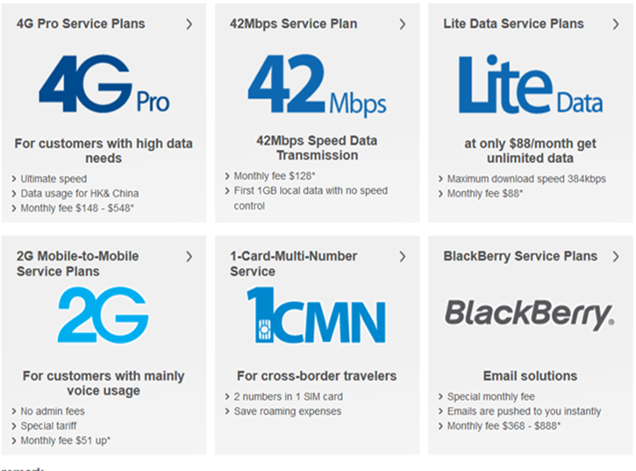
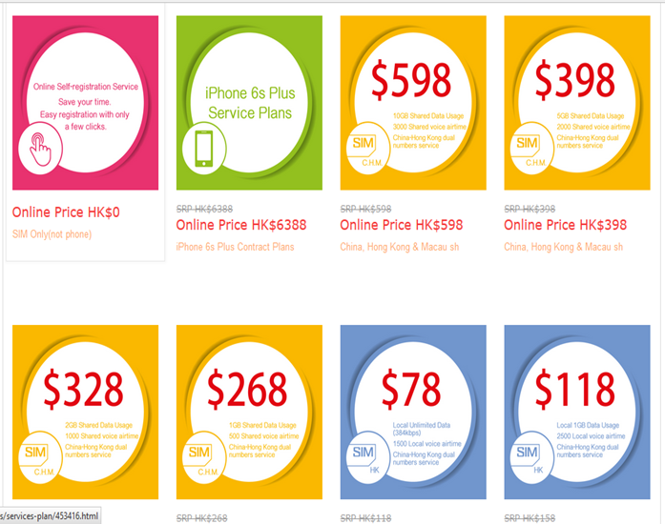
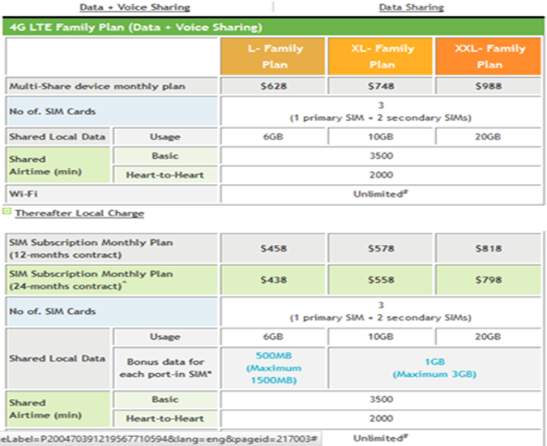
Pricing Comparison
The prices for the subscriptions under the China Mobile Limited and competitors are dependent on the selected service being provided.
Monthly Service Plans 4G:
China Mobile Limited
China Unicom Limited
Hutchison Telecom
Notes:
Calvin

Slide 8
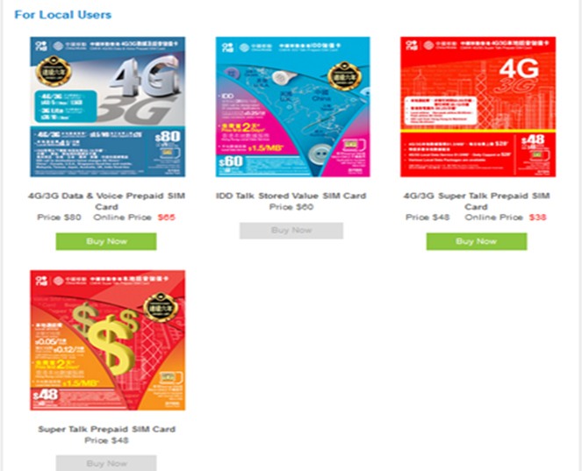
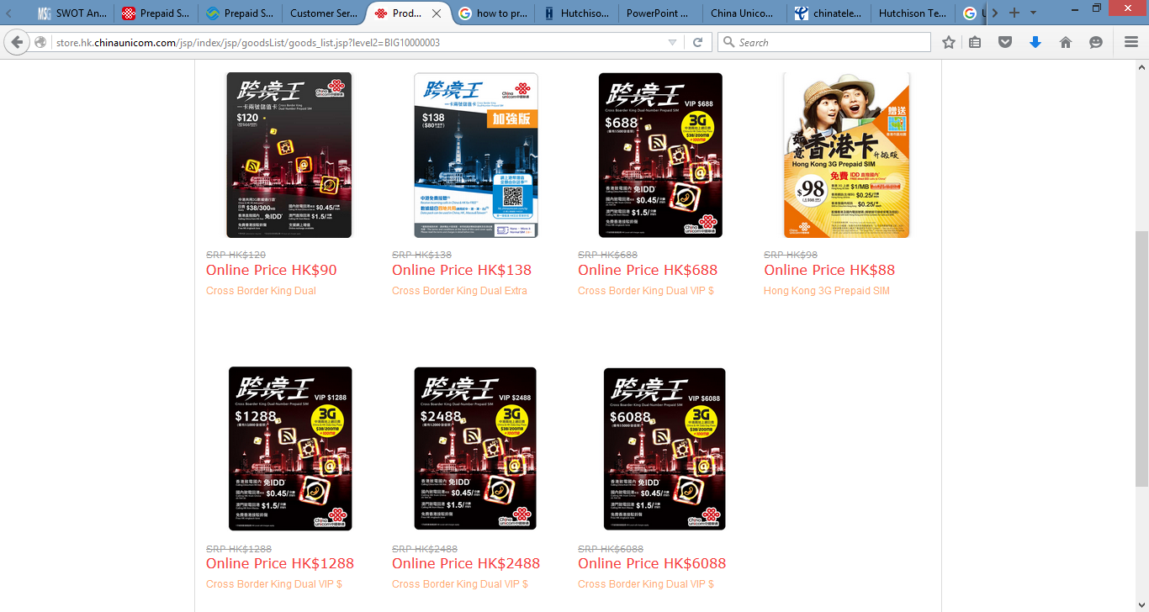
Pricing Comparison
The prices for the subscriptions under the China Mobile Limited and competitors are dependent on the selected service being provided.
Prepaid Users:
China Mobile Limited
China Unicom Limited
Hutchison Telecom
Notes:
Calvin

Slide 9
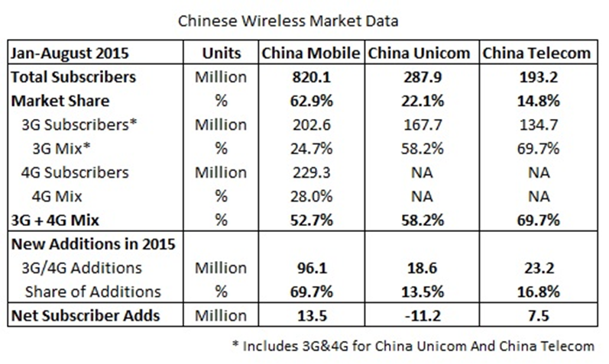
Pricing Analysis
The China Mobile Limited and all its major competitors such as China Unicom Limited, China Telecom Stocks Co. Ltd., and Hutchison Telecommunications all have different prices. However, all their prices are dependent on the services being afforded by the customers.
All the prices vary in terms of the gigabyte, the type of service, monthly cost and prepaid.
The trend of pricing is all the same among the aforementioned telecommunications companies. Prepaid prices are cheaper as they are pay as you go. Fixed-line and Wi-Fi broadband lines are priced differently too. Data and other value-related services have their own corresponding prices.
Notes:
Calvin

Slide 10
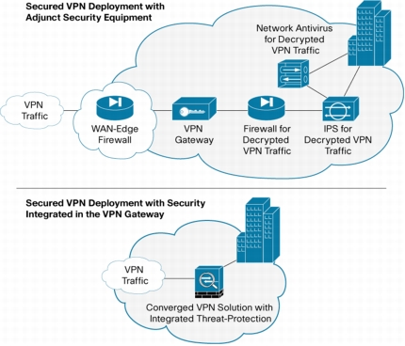
Benefits
The China Mobile Limited, China Unicom Limited, China Telecom Stocks Co. Ltd., Hutchison Telecommunications share the following benefits:
Remote Access- All these companies are able to get provide services in all mainland China and Southeast Asia.
Strong Customer Base- Undeniably, these companies have their own strong customer-base and profitable market share locally and in other parts of Southeast Asia.
Pricing Flexibility- The pricing of the products and services of China Mobile Limited and its three major competitors are flexible enough to maintain its clientele.
However, only Hutchison Telecommunications has a stronger international and global presence in the Western countries such as Europe and North America. This situation puts the company in a more strategic and advantageous position.
Notes:
Calvin

Slide 11
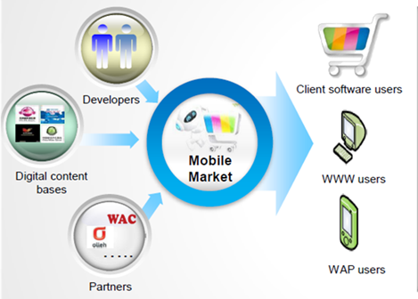
Service Channels
Hutchison Telecommunications:
Website and Mobile Compatibility
Local and Global Offices
Customer Service Hotline
Online Shops
200 Million worldwide
China Telecom Stocks Co. Ltd:
Website and Mobile Compatibility
Local Offices
Limited Online Shops
185.62 Million Customers
Notes:
Calvin

Slide 12
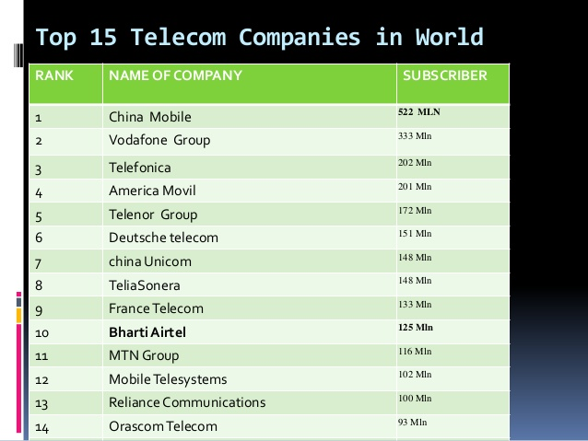
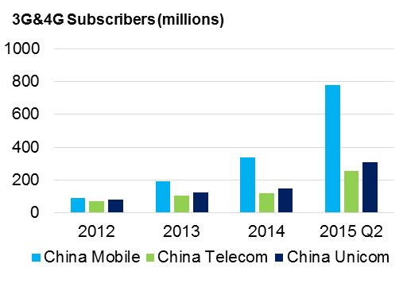
Success
All 4 companies are experiencing huge success when it comes to gaining and maintaining their own clientele and profitable market share.
Clearly, these companies all share the same ideology that customer satisfaction is the key to profitability and increase demand.
The success of these companies are expounded on the million subscribers they have. In addition, the companies are monetizing on the demand of its subscribers and potential clientele. They listen to what the consumers want and need rather than force what the company think the consumers need.
Local presence of the companies are definitely strong.
Notes:
Calvin

Slide 13
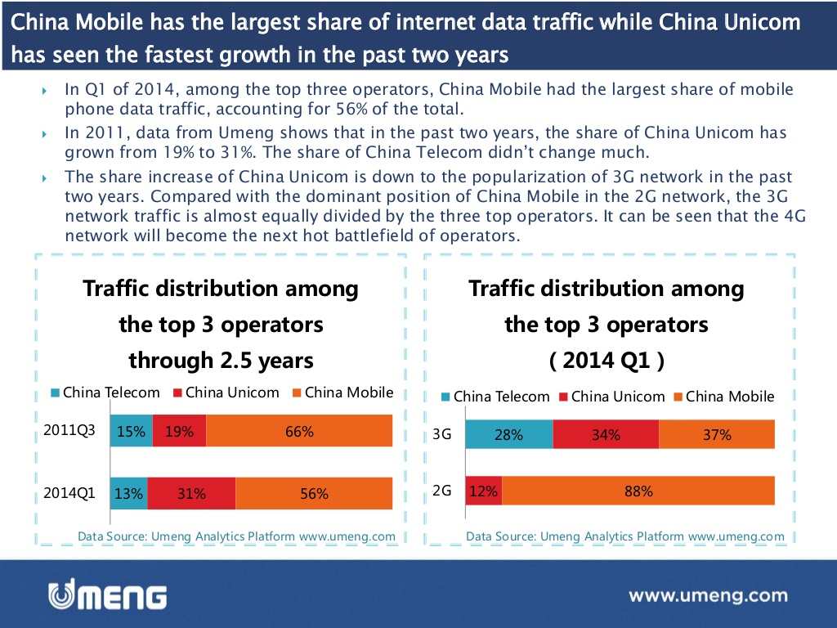
Conclusion
The China Mobile Limited is a successful business on its own. It has almost over 800 million of subscribers in China alone. However, the competition is getting stronger with each passing day with the emergence of new companies that offer the same values, products and services that China Mobile Limited is providing to its consumers.
The company is growing rapidly regardless of the competition with almost 50% growth yearly.
China Mobile Limited has started to exert efforts in trying to enter and dominate international markets like the strategies being utilized by the Hutchison Telecommunications.
Notes:
Calvin

Slide 14
Recommendations
China Mobile Limited must lay out strategic plans and guides to enter the international markets. Ideally speaking, it must increase its presence in the Southeast Asia to start and then work its way up to Western countries and in greater American regions.
Attractive phone services and packages must also be focused upon since the consumers are always looking for great deals not just on phones but also on subscription plans. The increasing competition between telecommunications companies will drive the prices down and it will be in the advantage of China Mobile Limited to exploit such opportunity.
Discounts and online exclusives should be one of the strategies that China Mobile Limited should look into to attract new customers while maintaining its loyal subscribers. Promotions and marketing are two concepts it should also target.
Notes:
Calvin

Slide 15
Recommendations
The company must also pave the way for product expansions. Meaning to say, it does not have to rely solely on the other manufacturers for its cellular phone distribution. It can also start manufacturing their own cellular brand. In this way, it can boost its profitability by selling phones with monthly and prepaid plans that can be offered exclusively by the company to its consumers.
It will also help in the journey to access international market by utilizing famous people for promotions. This is a proven way to increase market exposure and customers’ following.
Specialty shops and online presence are necessary to increase global and international presence of the company. This is particularly true in a world where people are resorting to online shopping.
Notes:
Calvin

