Slide 1
Interview with a Healthcare Policymaker
Understanding how elderly patients could be helped with fall prevention issues
Notes:
This presentation entails to note the distinct points considered in an interview held with a policymaker in resolving issues that are relatively directed towards creating a more expansive form of nursing procedures in preventing falls among elderly patients.

Slide 2
Interview Brief (1)
Interviewee: Mrs. Lee
Company/Institution Affiliation:
Fall Prevention Center
Position of Interviewee:
Attendant/ Supervisor
Interview Theme:
Improving policies that would provide a more expansive process of supporting elderly in avoiding falling incidents
Procedure Adapted:
Single-focused interview with officer of the concerned institution
Notes:
This interview has been completed to make a definite form of indicative presentation of information that would provide a more expansive pattern of development on how elderly patients are to be protected form falling incidents.

Slide 3
Interview Brief (2)
Importance of Topic in Healthcare:
Identifies what specific groups are working towards the development of effective policies that are dedicated to protecting the elderly from falling incidents
Specific Goal:
Understand the efforts of institutions like Fall Prevention Center to provide the elderly with the needed assistance as they are protected from falling
Notes:
The interview intends to discover the importance of social structuring as a form of strategy that institutions use in order to impose a sense of urgency that is needed in order to create a more definite guideline as to how falling among elderly patients could be prevented. This would make a definite impact on how the issue itself is understood and give an overview on how the problem is being resolved through effective healthcare management

Slide 4
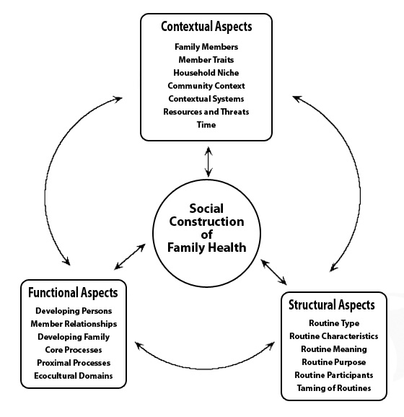
Supporting Data for Interview
Notes:
This form of viewing the situation and understanding how it could be resolved is defined through the social construction of family health which is used as a basis of understanding in analyzing the results of the interview.
The different works and efforts of the society is one that basically responds to the consideration that organizations like the Fall Prevention Center respects
-for this interview, such pattern of social involvement is expected to make a difference on how falling incidents among the elderly are supposed to be prevented

Slide 5
Theories Tested during Interview
Personal assessment of the case of patients
-this defines how a patient understands
his situation improving the way he manages his condition accordingly
Increasing Social Knowledge
-improving how the society understands the issue improves the involvement they have on the solution
Developing Specific Policies for Better Function
-established policies expected to improve the way elderly patients are dealt with
Notes:
These theories of improving the resolution presented for the problem are expected to create a more valuable application of the information received from the interviewee

Slide 6
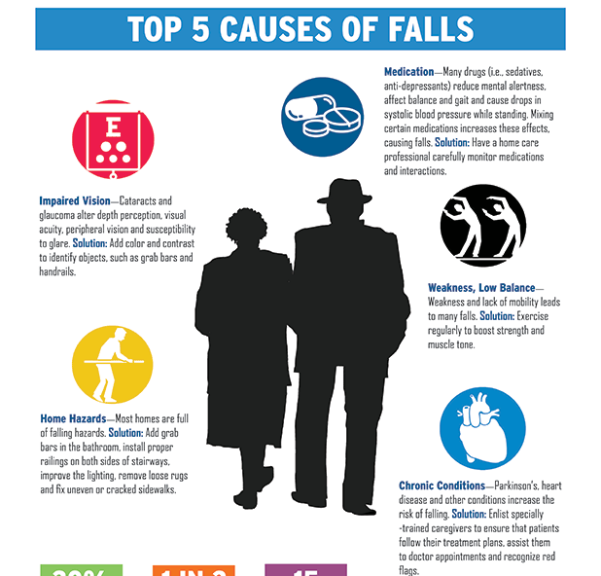
Hand Out Received
This handout was provided as basis of the development that the organization depends upon as falling incidents are analyzed by the organization
Notes:
This handout is one that the institution uses to provide families, caregivers and other members of the society the information they need to understand the situation of the elderly individuals and what likely are the reasons for falling that ought to be prevented accordingly.

Slide 7
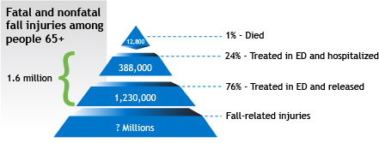
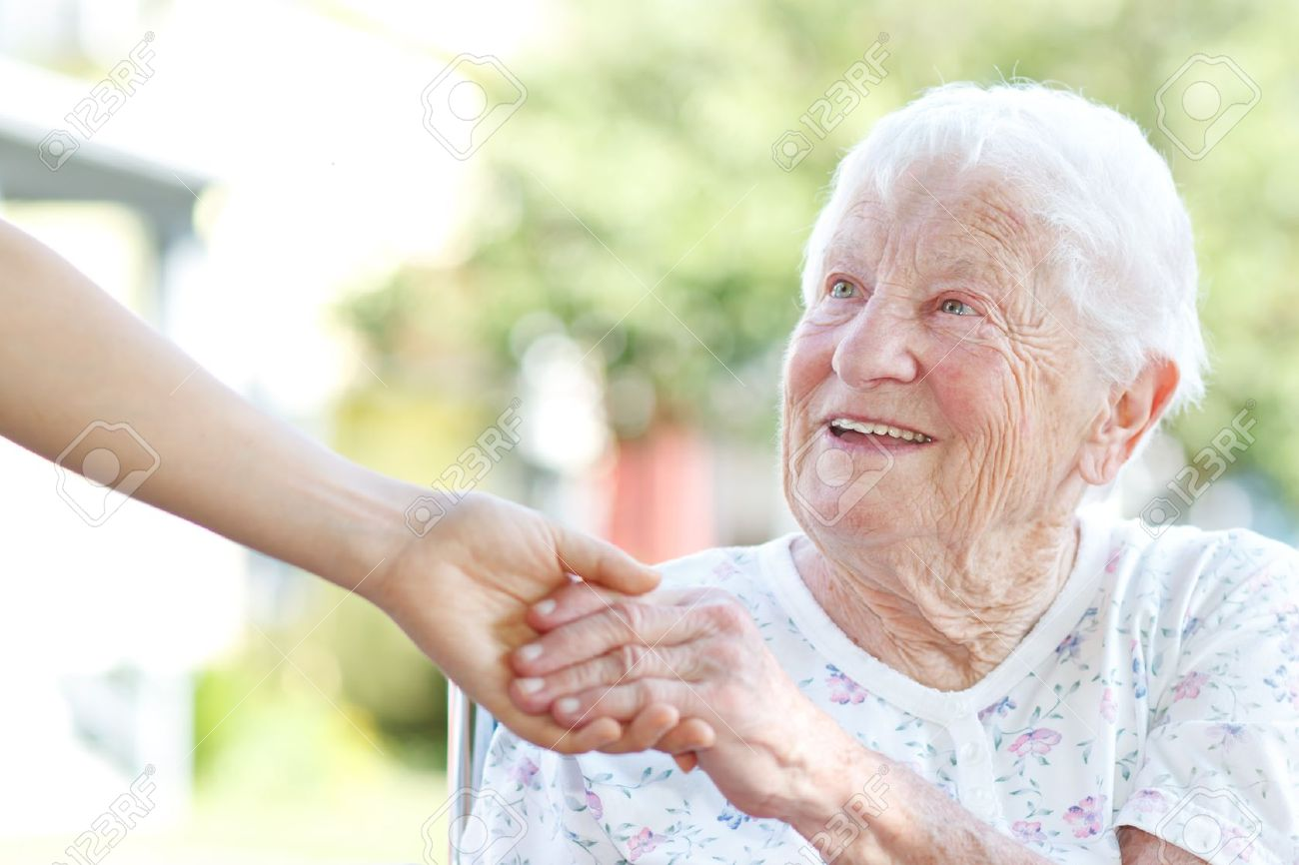
Learning from the Interview
This rate of falling among elderly patients indicates the seriousness of the problem
Notes:
Mrs Lee indicates the gravity of the issue. This can be felt in the tone of her voice. She says, “… this is an issue that affects society more than people realize it and they have to know how bad the situation is. Old age is a time when most people are particularly vulnerable to falling. We need to recognize that this is a problem in the modern day world….”
Mrs Lee believes that support groups are the best way to get one’s voice heard. She says, “Collectively, people tend to have a bigger impact that individually. This is the foundation for tackling the problem on the community level …”
She indicates that a proposal to lobby support to develop social policy to help solve the problem. She said, “I would take it into consideration. However, you have a better chance going through the support and interest groups. They tend to have a larger audience.

Slide 8
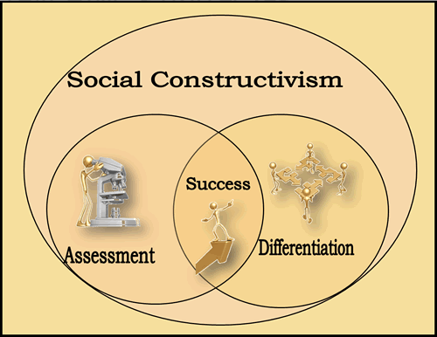
Learning from the Interview
The interviewee Implied that:
-in the process of understanding the situation, the society’s response is important
-the assessment of the problem is handled by social institutions
-differentiation of issues ought to be considered
-success is achieved as people become more aware of the problem
Notes:
She says she has been in contact with some of the support groups within California. She mentions the Fall Prevention Centre, which is made up of 6 distinct institutions working together for a single cause. “… this is the largest collection of support and interest groups within the state of California. They also have considerable bargaining power and they have a voice. Working with them would help you reach your goal…..”
She also highlights the vVisting Nurses Services. She says this is the best source for information pertaining to research on the area and the condition foo the problems within the state.
Her tools of choice are workshops and small taskforce meetings. She has managed to help independently organized workshops and attend small taskforce meetings regarding the issue. These workshops provides her with an opportunity to hear the concerns of support groups.

Slide 9
Learning from the Interview
Family involvement
Government Empowerment
The leadership of the government agencies in creating resolution to the issue is part of the success of getting the society involved
Providing information to family members about what adjustments they should make
The interviewer mentioned that part of the process of development is the creation that is established between families and government agencies dedicated to protecting the health of the elderly members of the society
Notes:
Mrs. Lee noted that community involvement is not adequate enough to meet the challenge the county faces with regards to the issue of preventing falls in the elderly. She underlines the fact that there is considerable need for further community involvement.
There are very few avenues through which the community can be involved. There is need to increase these avenues. Mrs. Lee highlighted three areas that are lacking in terms of the ability to effectively raise awareness. One of the most prominent is society’s response to the issue. Most individuals who are responsive to awareness programs reside with an elderly person at least 55 years and above. Most people prefer to place the elderly is elderly homes. As such, the community is considerably unresponsive to awareness efforts.
She believed that community involvement is less than the required level as the issue seriously affects society.

Slide 10
Learning from the Interview
Problem arises because of lack of knowledge
Caregivers need to be trained
Government institutions should have proper funding
Nurses attending to elderlies ought to be trained
Elderly patients should be oriented and assisted with proper knowledge
Mrs. Lee points out that these problems are evident and there are available solutions to be applied to fix the issues connected to falling cases among elderly
Notes:
She believes that the key is to take a three pronged approach. She says, “… Firstly, get involved with the support and interested groups, they will provide you with a platform to raise awareness on the issue. Secondly, make sure your efforts are on a national scale. Campaigns such as HIV/AIDS and Cancer have been successful because of the national platform they sought. Finally, involve policy makers. They will drive your agenda to realize a legislative solution…..”
there are a number of challenges that Mrs Lee highlights. Such efforts require a considerable amount of finances.. Most solutions would incur considerable costs due to the nature of the problem. The availability of these finances makes it difficult to make any significant advances.

Slide 11
Reflections on Interview
ADDITIONAL FACTS
Accidental falls are the most common causes of nonfatal injury in older adults over the age of 65*
Falls are a very common phenomenon in elderly people.
Higher death rates in males over the age of 85 years (Gaffey, 2015).
For older adults over the age of 85, these numbers shift dramatically upward, with males experiencing higher rates of death from falls.
Need for increased government and community involvement (Gielen, McDonald, &Shields, 2015)
Lack of cohesion on a national scale
Interventions required on a national scale
Need for preventive measures
Notes:
The interview with Mrs Lee shed some light on a number of new insights pertaining to the development of policies pertaining to the prevention of falls among individuals above the age of 65 years. Older individuals over the age of 65 frequently experience falls. This is a result of age and susceptibility to certain illnesses that make their bodies frail. As such, the magnitude of the problem has largely been understated.
It is important to establish preventive measures at the individual level and from healthcare facilities in an effort to reduce the number of patient falls that occur
This includes the ability to prevent falls through formalized programs so that the general public, as well as patients and their families, are aware of the nature and extent of this problem
It is important to develop a community-based awareness program that will increase the level of understanding of falls risk for older adults
It is also necessary to consider federally sponsored education and awareness programs in an effort to promote policymaking at this level
The interview also revealed that individuals over the age of 85 years, especially males, are even more susceptible to falls and injuries caused by falls. These injuries may at times be fatal.
There is very little government and community involvement in tackling the issue. While support for the cause is growing, it does not match the required effort for a sustainable solution to the problem. This is further compounded by the fact that there isn't enough cohesion between interest groups. There is need for cohesion on a national level.

Slide 12
Reflections on Interview
IMPORTANCE TO NURSING
Nurse-to-patient staffing ratios are essential in falls prevention
Higher ratios often translate into reduced fall rates (Cmica et.al, 2013)
Mortality rates associated with falls may be preventable through nursing-related activities
Unanticipated events, such as physiologic events, may occur and require continuous monitoring (Gielen et.al, 2015).
Fall-related injuries in nursing homes may be reduced with increased staffing levels for nurses (Gaffey, 2015).
Notes:
The following information basically provides distinct indication on how the nursing response to such issues could be established well:
Throughout the United States, falls prevention has emerged as a topic of discussion in many communities, but it remains a challenge to convince many policymakers of its relevance in supporting the health and wellbeing of older adults.
Evidence-based practice may bridge some of these gaps and offer a means of exploring the extent of the problem and its impact on the older adult population
Through the identification of falls risk within specific communities, lawmakers may begin to recognize the serious nature of this problem and aim to prevent falls through official programmatic efforts or legislation within this area of focus
Older people have a higher tendency of falling than their younger counterparts. Falling among the elderly is a severe public health issue with a considerable effect on the health care costs as well as the Individuals general health (Willhoss, Yohannes & Mitchelle, 2010).
Falls rank as one of the majority regular aged syndromes that threaten the freedom of older people (McClure, Hughes, Ren, MacKencie, Dietran, Vardon & Newman, 2010). Additionally, they are the top reason for injury deformities and deaths among individuals aged 65 years and above.

Slide 13
Reflections on Interview
Value of Interview
Improving Realization over the Issue
Evidence-based facts prove the prevalence of the problem
Creating a better vision on the solutions needed
The need to increase involvement of the society in the solution is established
Provides a more constructive process of including everyone to the solution designed
Participation of everyone is empowered
-individuals involved are motivated
Notes:
The interview provides a more constructive pattern on how different agencies in the society are further empowered to respond to the issues accordingly thus resolving the situation more effectively. These procedures could be considered as follows:
Participation breadth is the magnitude to which community members are offered the opportunity to take part in every stage of the policy development and execution process. Participation depth is the extent to which the participating citizens can influence the final outcome through the process of participation.
Local democracy can be achieved by building social capital through integrating interpersonal connections with civic commitment these interpersonal connections are vital in community needs can be amalgamated to create social capital within specific groups and creating a bridge between different interest groups within the community.
Developing social policy with regards to the prevention of falls in elderly individuals can only be achieved through collective bargaining
Putnam and Feldstein postulate that getting citizens involved in civic issues is dependent on two crucial elements (1) taking advantage of bonding social by supporting people to organize activities within their own communities or social identities, and (2) developing bridging social capital by helping individual communities and neighbourhood groups to network to develop intricate connections between each (Putnam & Feldstein, 2003).

Slide 14
Future Opportunities
Improved Technology dedicated to looking after the case
Improved budget direction to develop better policies of elderly assistance
Determined course of develpoing elderly healthcare guidlienes
Notes:
This interview opens the opportunity for the healthcare industry to become more aware of the condition of responsibility that is placed upon their shoulders as they handle a more consistent process of establishing a workable policy that would create a more progressive pattern of helping elderly patients.
Some of these future opportunities include the following:
Falls within the older adult population is a continuous problem with serious complications for older adults. Therefore, it must be openly discussed in order to achieve greater success in promoting effective outcomes for this group of patients being assisted.
Examples of successful falls prevention programs will be useful and provide additional support for this endeavor
Real-life examples will play a role in demonstrating the need for legislation to enhance falls prevention
Any legislative action that is taken must be supported by community members and must be practical and appropriate for the affected population

Slide 15
Recommendations
Improving knowledge improves better response
The problem exists but it could be resolved if it is better understood by concerned individuals and agencies
Developing policies for fall prevention assisted through healthcare agencies and IT involvement
Information technology could improve courses of support needed by the target patients
Notes:
It is recommended that social knowledge be improved especially in relation to creating workable policies that help out nurses and caregivers in providing the assistance needed by the elderly patients.
It is also recommended that IT applications be used to improve the implication of the policies made to establish better elderly assistance against falling thus reducing risks accordingly.

Slide 16
Conclusion
Falling incidents among 65+ year olds is a serious problem
Resolving issues regarding falling could be completed through improving knowledge development
Involving social assistance could provide a more prospective support needed by families and agencies in resolving the problem
Notes:
It could be concluded from the interview that falling incidents among patients above 65 years of age is more prevalent therefor should be addressed accordingly.
The society’s response to the issue better improves resolutions that are designed to lessen cases of falling among individuals above 65 years of age.

Slide 17
References:
Centers for Disease Control and Prevention. (2015, September 21). Important Facts about Falls: Falls Are Serious and Costly. Retrieved from http://www.cdc.gov/homeandrecreationalsafety/falls/adultfalls.html
Crnica, V., Mujkić, A., Young, T., Miškulin, M., & Peek-Asa, C. (2013). Healthcare Providers' Knowledge, Attitudes and Counselling on Injury Prevention for Preschool Children in Croatia. Maternal & Child Health Journal, 17(9), 1718-1724. doi:10.1007/s10995-012-1165-x
Gaffey, A. D. (2015). Fall prevention in our healthiest patients: assessing risk and preventing injury for moms and babies. Journal Of Healthcare Risk Management: The Journal Of The American Society For Healthcare Risk Management, 34(3), 37-40. doi:10.1002/jhrm.21163
Gielen, A. C., McDonald, E. M., & Shields, W. (2015). Unintentional Home Injuries Across the Life Span: Problems and Solutions. Annual Review Of Public Health, 36(1), 231-253. doi:10.1146/annurev-publhealth-031914-122722
National Council on Aging (2009). Falls Free Initiative: Advancing and sustaining a state-based falls prevention agenda: the role of legislation, policy, and regulation. Retrieved from https://www.ncoa.org/wp-content/uploads/State-Fall-Prevention-Legislative-and-Policy-Initiatives.pdf
Sward, D. (2010). Preventing falls among older Americans. Retrieved from http://www.ncsl.org/portals/1/documents/health/1821falls.pdf

