Slide 1
Presentation on Elucidating Stress Adaptation Responses of Listeria Monocytogenes
NAME
INSTITUTIONAL AFFILIATION

Slide 2
Purpose and Outline
Purpose of this presentaion is to seek elucidation of Stress Adaptation Responses of Listeria Monocytogenes.
Outline:
Introduction
Background
Methodology
Results
Acid
Osmotic
Cold
Heat
alkaline, and
oxidative stress responses in the L. monocytogenesis bacterium.
Role of r Factors in L. monocytogenes Stress Adaptation
Conclusion.

Slide 3
Methodology
Transcriptome and proteome stress analysis – Most exeriments used this methodology to examine the reaction of Listeria Monocytogenes to stressors,
Literature Review - various studies have been used to study the reaction of Listeria Monocytogenes to stressors

Slide 4
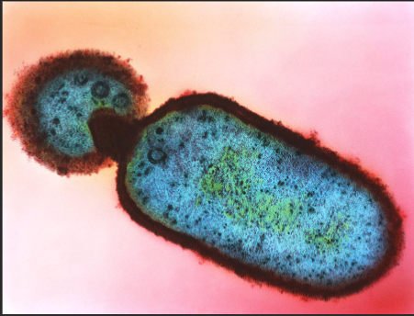
Introduction
Lysteria monocytogenesis is a food safety concern.
Targets immunosupressed individuals.
Is one cause of high mortality rates.
Grows on food products.
Survives food processing and preservation procedures.

Slide 5
Graph showing Listeria Monocytogenes Outbreak.

Slide 6
Background
Environmental stress challenges show monocytogenes cells that rely on diverse strain pathways.
The processes identify stress-related molecular difficulties.
They detect molecular stress issues by modifying expression of genes and functional activities of proteins.
Understanding into the alterations in expression of genes that occur throughout stress adaption.
Transcriptome analysis has lately yielded reactions.

Slide 7
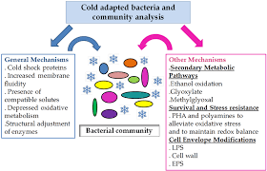
Cold stress adaptation responses
L. monocytogenesis bacterium faces a lot of molecular strain when exposed to cold.
Cell wall stiffness has been enhanced.
Protein and biochemical processes are diminished.
Processes of slow transport and nutrient absorption.
Transcriptomic mechanisms are delayed.
Protein disintegration and modification

Slide 8
Cold stress adaptation responses cont’
L. monocytogenesis bacteria experiences various molecular challenges when subjected to cold.
Increased structural stiffness
Decreased protein and biochemical processes
Sluggish movement and nutrient availability mechanisms.
Stagnated gene expression mechanisms
Protein degradation and modification.

Slide 9
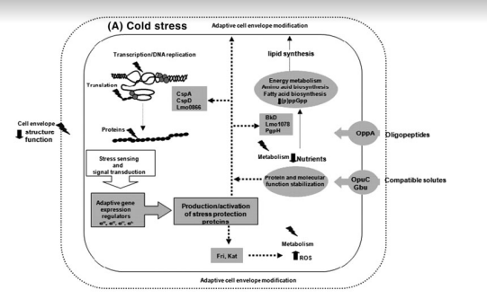
Adaptation to Cold Stress responses cont’
Two-component Systems (TCS) is vital in aiding cold stress adaptation.
They avail signal transmission pathways enabling cold stress sensing.
Putative TCS genes lhkA, yycJ, and yycF also transcriptionally activates in cold stimuli.

Slide 10
Adaptation to Heat Stress Responses of Proteins
Recap
Generally, exposure of proteins to heat destructs enzyme activity and denaturing.
Adaptation against heat stress include;
Cellular mobilization to restore nucleic functions and membranes.
Replacing degraded proteins with new proteins to facilitate metabolic funtions.

Slide 11
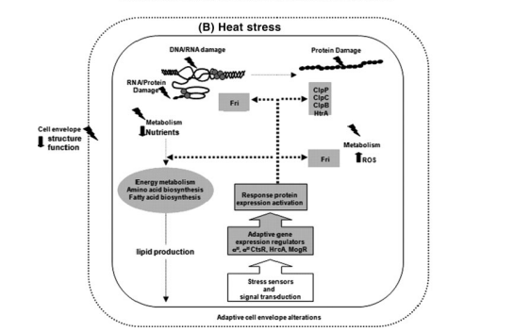
Heat Stress Adaptation Responses of L. monocytogenes
L. monocytogenes adapts by cell division and synthesis of the cell wall when expose to heat.
Responses to heat shock is as a result of production of heat shock proteins (Hsps).
L. monocytogenes has class I and III heat responce groups.
These groups reactions are controled via HrcA and CstR transcription repression activities.

Slide 12
Heat Stress Adaptation Responses of L. monocytogenes cont’
Proteome analysis is used to determine L. monocytogenes and heat stress responses.
L. monocytogenes react by higher release of of GroEL and DnaK.
This invokes continuous Hsps helping to remove heat damaged proteins in L. monocytogenes cells.
The fri gene transcipts being heat stress inductible, destroyed L. monocytogenes cells with high heat sense.

Slide 13
Osmotic Stress Responses of L. monocytogenes
Recap;
Sodium salts and high sugar levels is typically used as food preservative.
This method threatens bacterial cells survival through dehydration.
Leading to higher solute composition inside the cell .
Finally, there is distortion of a number of biological mechanisms.

Slide 14
Osmotic Stress Responses of L. monocytgenes cont’
Proteome analysis was applied to examine osmotolerance communication in L. monocytogenes.
Results: Twelve osmotic stress acclimation proteins presented .
They are; the HtrA, GbuA, DnaK, AppA, OpuC, and Ctc, proteins (Duche et al.,
Accumulation of osmolytes is key osmotic stress adaptibility strategy in L. monocytogenes.

Slide 15
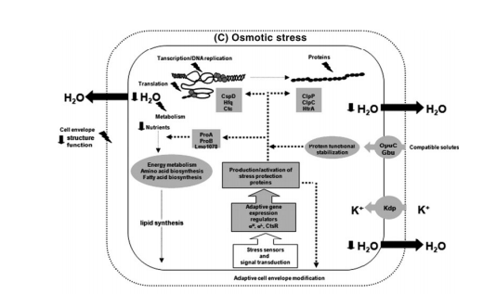
Osmotic Stress Responses of L. monocytogenes cont’
Systems like BetL, Gbu, and OpuC transport, taking part in glycine betaine and carnitine usage, support the bacterium’s growth amidst the stress of osmosis.
K+ is fond of the cell wall which supports osmosis roles in L. monocytogenes cells.
Source:
:

Slide 16
Acid Stress Adaptation Responses of L. monocytogenes
Organic acids employed as feed additives decontaminants inorganic acids found inside human beings' digestive systems are among the acid stress problems experienced by L. monocytogenes cells.
Antibacterial strategies versus organic acid stress are widely assumed to be dependent on their separation in cytoplasm of the cell bacterium, which results in acidity in addition to proton and anion inflow.
While proton inflow reduces cellular ATP generation and transport capabilities, ionic influx, and acidification into the cytoplasm disturbs metabolism activities and destroys proteins, nucleic acids, and cellular membranes.

Slide 17
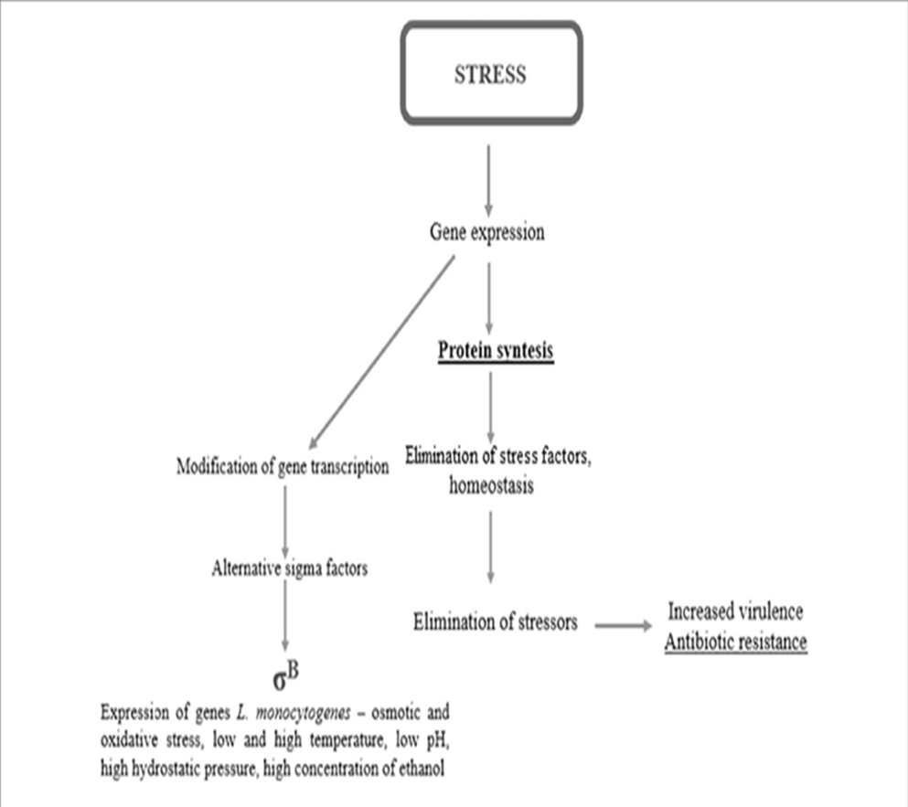
Acid Stress Adaptation Responses of L. monocytogenes cont’
A study by Bowman et al. (2010) on the response of L. monocytogenes to organic acid stress showed that stress was linked to a wide range of transcription, involving higher activation of rB, PrfA, HrcA, and CtsR targeted areas, cellular oxidative responses, DNA repair, intermediate metabolic activity.
Organic acid salts boosted oxidoreductases and lipoproteins while decreasing DNA-binding proteins, alpha-amylase, and SecA in L. monocytogenes.
ScottA cells.L. monocytogenes cells subjected to organic acid stress inhibit the DNA-binding proteins alpha-amylase and SecA.

Slide 18
L. monocytogenes Response to Alkaline Stress
Sublethal alkaline stress linked with detergent and sterilizing compounds used as food hygiene procedures may commonly be encountered by environmental L. monocytogenes strains residing foodprocessing settings.
Metabolic alterations to promote acid production are among the adaptive mechanisms used by bacteria in alkaline stress adaption.
Transmitters and biochemical processes in proton conservation are activated.
Adjustments to the cell membrane that increase cytoplasmic proton preservation.

Slide 19
L. monocytogenes Response to Alkaline Stress cont’
390 gene transcripts are differentially expressed in L. monocytogenes cells in reaction to alkaline stress.
Alkaline stress genes contribute to stress stimulation, transportation of the solution, and pathways of metabolism (Giotis et al., 2010).
L. monocytogenes cells subjected to alkaline stress synthesized or overexpressed a restricted number of proteins, whereas a correspondingly large number were repressed (Giotis et al., 2008b).
Alkaline stress exposure also produced DnaK and GroEL.12 mutant strains become alkaline-sensitive due to defective transporter genes.
According to studies, nothing has been established about this bacterium's alkaline stress protein systems.

Slide 20
Role of r Factors in L. monocytogenes Stress Adaptation
r factors encode and regulate proteins that protect L. monocytogenes cells from stress.
“rB is a positive regulator of multiple overal as well as response to cold stress genes fri, oppA, opuCA, and ltrC”. (Chan et al., 2007).
L. monocytogenes mutant strains missing rC, rH, and rL “(RpoN) alternative sigma factors reveal that, like rB, they regulate cold adaption pathways in this bacterium” (Chan et al., 2008; Raimann et al., 2009).
Wearing out of rc function enhances L. monocytogenes' heat senses (Zhang et al., 2005).

Slide 21
Role of r Factors in L. monocytogenes Stress Adaptation
According to transcriptome profiling, rB-controlled genes in osmotic stress adaption are involved in;
overall response to stress,
transcriptional control,
Transit of cells,
surface alteration of metabolic activity,
synthesis of protein and alteration,
virulence (Raengpradub et al., 2008).
rB controls osmolyte transit genes (opuCA and gbuA).

Slide 22
Cross Protective Stress Responses
Multiple studies suggest that chronic, low-level exposure to stress results in the evolution of L. monocytogenes that is biologically more resistant to higher doses of the similar or other stressors.
For instance, L. monocytogenes cells that have been subjected to sublethal acid stress exhibit enhanced resilience to higher acid stress levels and develop improved tolerance to osmosis stress and heat (Gahan et al., 1996).
Preadapted L. monocytogenes cells exhibit increased resistance to osmotic and ethanol stress after being subjected to sublethal heat stress.

Slide 23
Conclusion
A better knowhow of the vital alterations haening at the levels of gene transcription in this bacteria's cells in response to stress conditions is essential for the creation of more successful food storage solutions.
Despite tremendous advances in understanding the L. monocytogenes stress response.
As a result, we believe that more research is needed to completely comprehend the molecular processes underpinning L. monocytogenes' cellular stress reaction in the context of diverse dietary components and environmental exposures.
The goal is for this fresh knowledge to lead to the development of more inventive approaches.

Slide 24
REFERENCES
Bowman, J. P., Lee Chang, K. J., Pinfold, T., & Ross, T. (2010). Transcriptomic and phenotypic responses of Listeria monocytogenes strains possessing different growth efficiencies under acidic conditions. Applied and environmental microbiology, 76(14), 4836-4850.
Gahan, C. G., O'Driscoll, B., & Hill, C. (1996). Acid adaptation of Listeria monocytogenes can enhance survival in acidic foods and during milk fermentation. Applied and environmental microbiology, 62(9), 3128-3132.
Raengpradub, S., Wiedmann, M., & Boor, K. J. (2008). Comparative analysis of the σB-dependent stress responses in Listeria monocytogenes and Listeria innocua strains exposed to selected stress conditions. Applied and environmental microbiology, 74(1), 158-171.
Yan, H., Neogi, S. B., Mo, Z., Guan, W., Shen, Z., Zhang, S., ... & Zhong, N. (2010). Prevalence and characterization of antimicrobial resistance of foodborne Listeria monocytogenes isolates in Hebei province of Northern China, 2005–2007. International journal of food microbiology, 144(2), 310-316.

